Slide 1
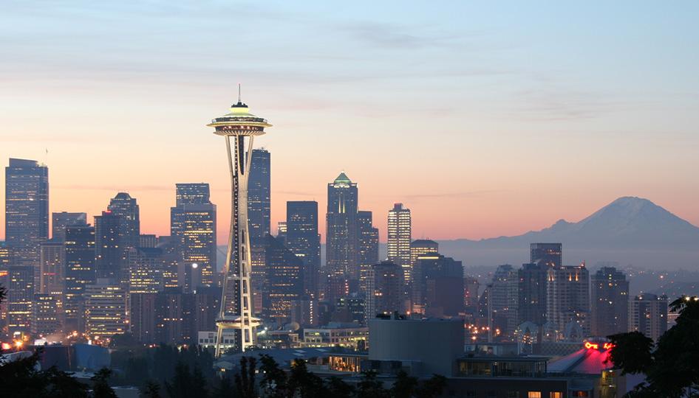
Predicting Strong Motions for Seismic Hazard Assessments in Seattle, Washington
Andrew Delorey
Final Exam
12/8/2010
Earth and Space Sciences, University of Washington

Slide 2
Acknowledgements
Advisory Committee
John Vidale
Paul Bodin
Mike Brown
Ken Creager
Marc Eberhard
Organizational Support
Also thanks to Art Frankel, Tom Pratt, and fellow students.

Slide 3
Outline
Motivation and Geologic Setting
Previous Work
Seismic Tomography
Predictions
Main Points

Slide 4
Why Predict Ground Motions?
Because Seattle experiences large earthquakes.
Because Seattle sits on a sedimentary basin that amplifies shaking due to earthquakes.
Because we don’t have enough observations to know what to expect during a damaging earthquake.
Because we need a statistical measure for determining building standards and planning for a natural disaster.

Slide 5
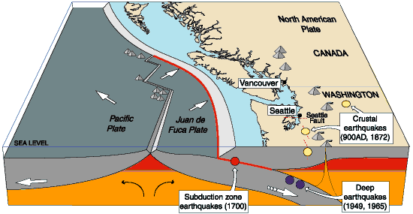
Seattle experiences large earthquakes
http://geomaps.wr.usgs.gov/pacnw/graphic/a1.gif

Slide 6
Seattle sits on a sedimentary basin
Troost [2008]

Slide 7
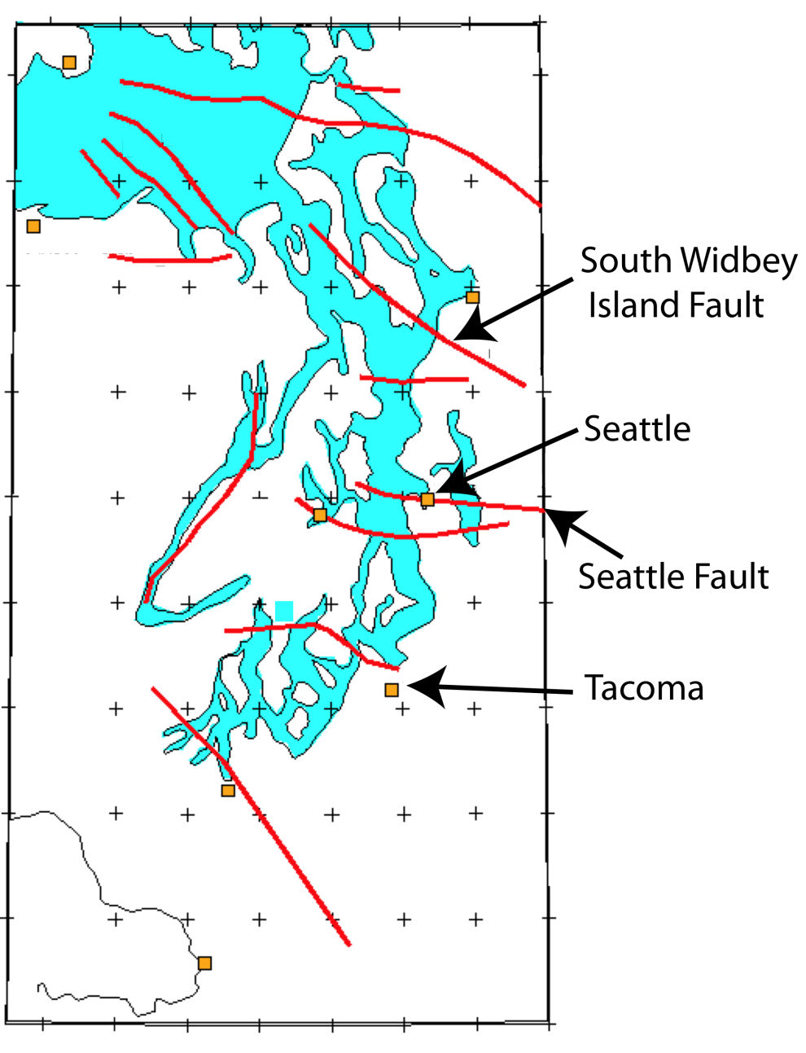
Seattle sits on a sedimentary basin
http://geomaps.wr.usgs.gov/pacnw/graphic/e.gif
[Modified from Grower, et al 1985]

Slide 8
Seattle sits on a sedimentary basin
[Brocher et al., 2001]

Slide 9
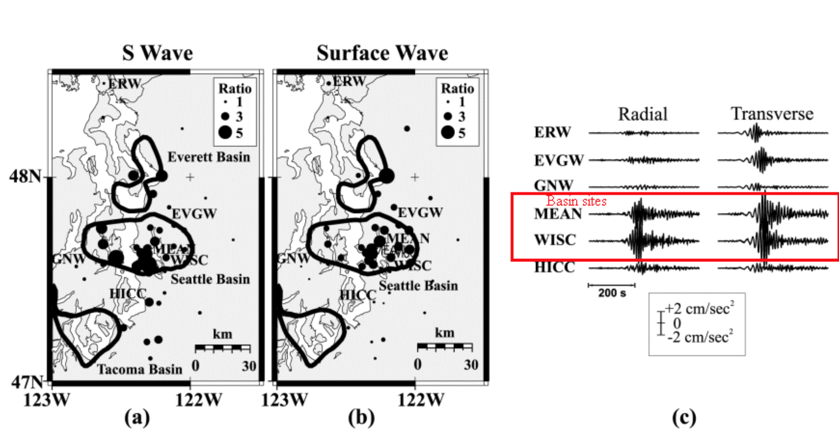
Amplified shaking during earthquakes Seattle - 2002 Denali 7.9
Barberopoulou et al., [2004]

Slide 10
Outline
Motivation and Geologic Setting
Previous Work
Seismic Tomography
Predictions
Main Points

Slide 11
Seismic Hazards in Seattle
2001 Nisqually 6.8
PGA = 20-25%g
1906 San Francisco 7.8
PGA = ~100%g
2009 Kingston 4.5
PGA < 0.1%g (in Seattle)
[Frankel et al., 2007]

Slide 12
Spectral Acceleration, PGA, PGV
Spectral acceleration is approximately what is experienced by a building, as modeled by a particle on a massless vertical rod having the same natural period of vibration as the building.
Incorporates mass, stiffness, and damping of a building.
Horizontal accelerations, produced by shear waves are the most destructive to structures.
P(H)GV, P(H)GA
$$m\ddot{x}+c\dot{x}+kx=f\left(t\right)$$
$$ω_{0}=\sqrt{\frac{k}{m}}$$

Slide 13
Quantifying Seismic Hazards
Probabilistic Seismic Hazard Analysis
Probability that the level of shaking (u) will exceed a given level of shaking (u₀).
Probability of getting an earthquake of each magnitude.
Probability of getting an earthquake at each distance.
Attenuation Relationship - Probability that shaking (u) exceeds a given value (u₀) for an earthquake with each magnitude (M) and at a each distance (R) for the each earthquake zone (i).
Probability of exceeding ground motion (u₀) in time duration (t).
THIS IS WHAT GOES ON THE SEISMIC HAZARD MAPS!
i = earthquake zones
j = earthquake magnitudes
k = earthquake distances
Sum over:

Slide 14
Quantifying Seismic Hazard

Slide 15
Putting it all together
Earthquake Scenarios
Regional Velocity Model
Basin Velocity Model
Site response
Non-linear response
Earthquake Simulations
u_{rock}
A_{3D}
A_{site}
A_{non-linear}
$$P\left[M=m_{j}\right]P\left[M=r_{k}\right]$$
$$P\left[u>u_{0}|M=m_{j},R=r_{k}\right]$$
$$λ\left(u≥u_{0}\right)=\sum_{i}{\sum_{j}{\sum_{k}{γ_{i}P\left[u>u_{0}|M=m_{j},R=r_{k}\right]P\left[M=m_{j}\right]P\left[R=r_{k}\right]}}}$$

Slide 16
Seattle’s Seismic Hazard Map
$$P\left[u>u_{0}|M=m_{j},R=r_{k}\right]$$
Predictions for u are highly dependent on the Vs model.
The Stephenson model uses P-wave velocity observations and Vp/Vs ratios to determine Vs.
There are no direct shear wave velocity observations used to make this map!
[Frankel et al., 2007]

Slide 17
V_{P}/V_{S}
Brocher [2005]

Slide 18
Why a new shear wave velocity model?
Shear waves cause the most damage during earthquakes.
The velocity model used to construct the current seismic hazard map uses a constant Vp/Vs for sedimentary rocks in the Seattle Basin.
Vp/Vs ratios in sedimentary rocks can vary from 1.5-3.5 according to data presented by Brocher [2005].

Slide 19
Outline
Motivation and Geologic Setting
Previous Work
Seismic Tomography
Predictions
Main Points

Slide 20
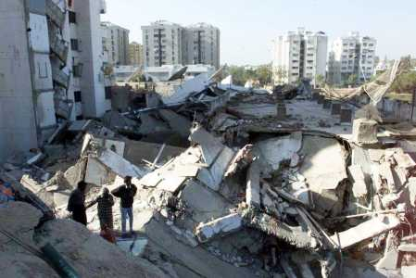
Using Ambient Noise
Is useful when a high density of stations is available
Does not require active sources or earthquakes
Is most often used to observe surface waves
Short-period surface waves are sensitive to shear wave velocities at the depths of the Seattle Basin.

Slide 21
Tomography
Data
87 Stations from the SHIPS array
Short Period (L22) 3-component instruments
Method
Noise interferometry
Surface wave tomography (Rayleigh)

Slide 22
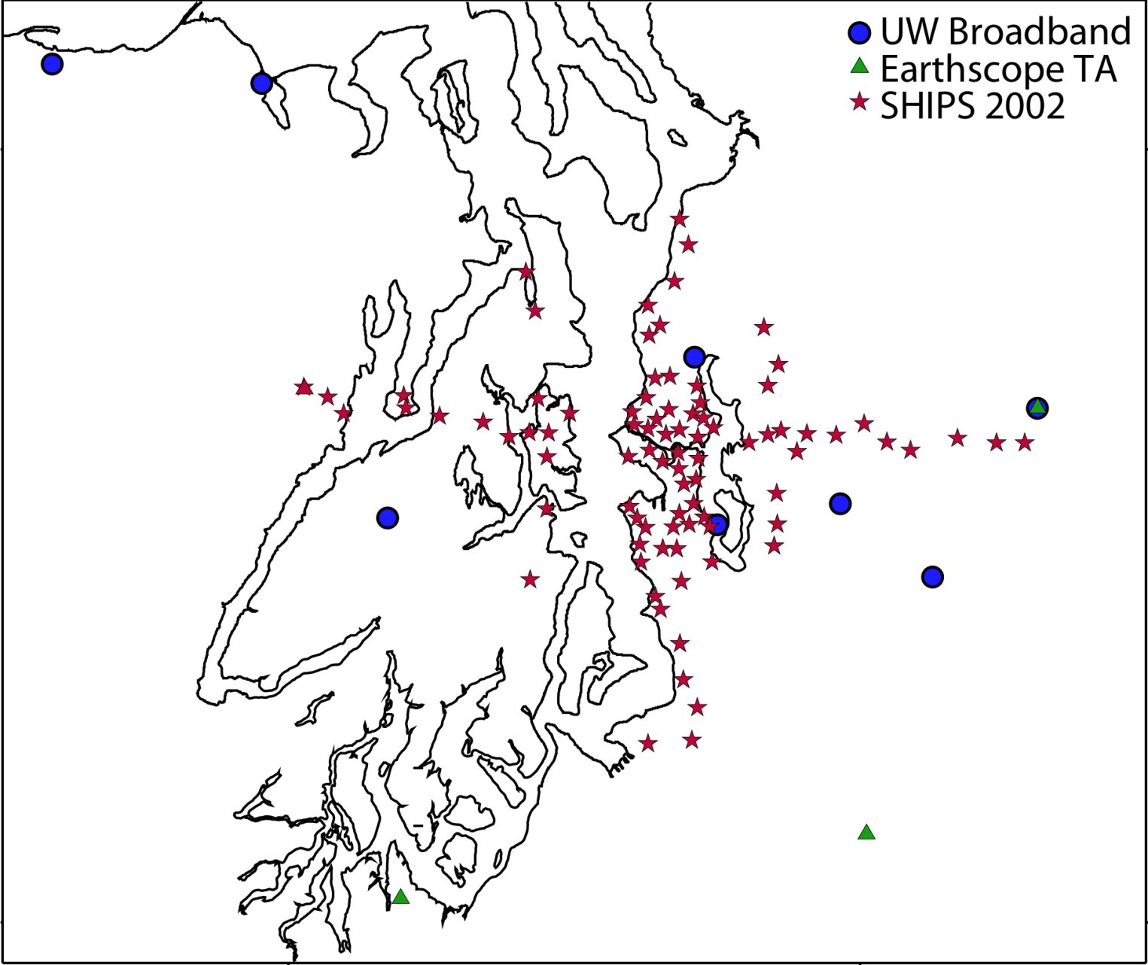
Data Set

Slide 23
Tomography
Extract Rayleigh waves from station pairs
Calculate Rayleigh wave phase velocity model using measurements from station pairs
Calculate Shear wave velocity model from the phase velocity model

Slide 24
Tomography
Extract Rayleigh waves from station pairs
Calculate Rayleigh wave phase velocity model using measurements from station pairs
Calculate Shear wave velocity model from the phase velocity model

Slide 25
Data Set

Slide 26
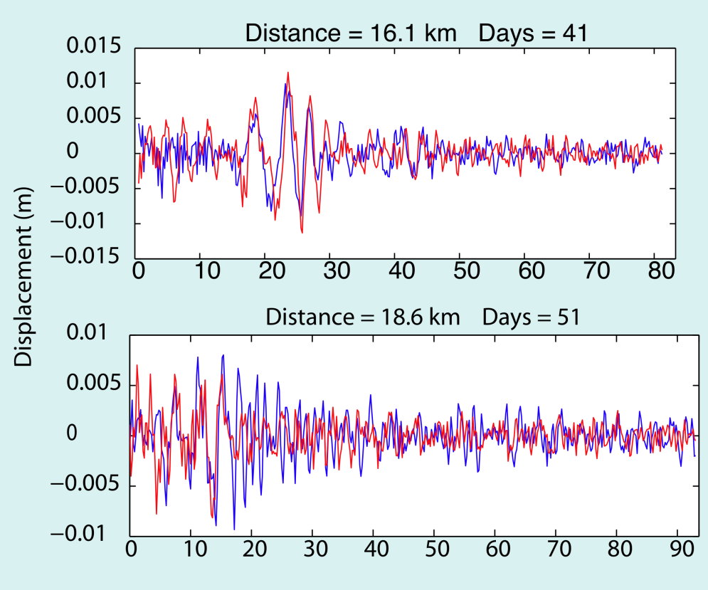
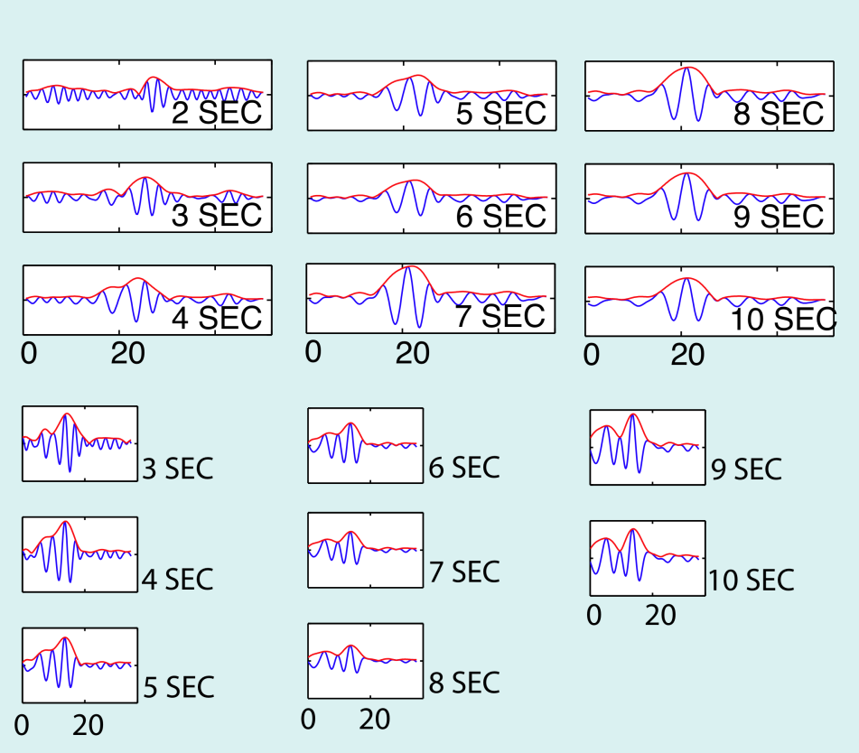
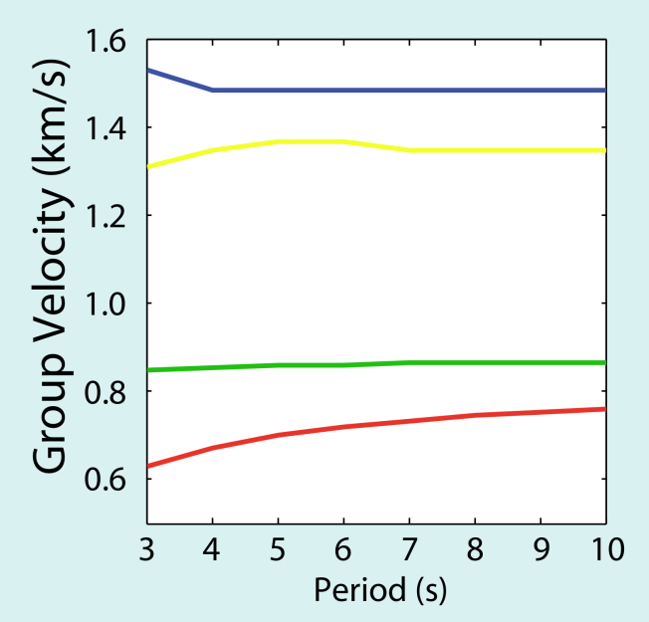
Processing Station Pairs
Extract Rayleigh waves by cross-correlating pairs of stations
Calculate Group Velocity as a function of frequency by bandpass filtering at a range of frequencies
Calculate Phase Velocity by integrating Group Velocity dispersion curve.

Slide 27
Tomography
Extract Rayleigh waves from station pairs
Calculate Rayleigh wave phase velocity model using measurements from station pairs
Calculate Shear wave velocity model from the phase velocity model

Slide 28
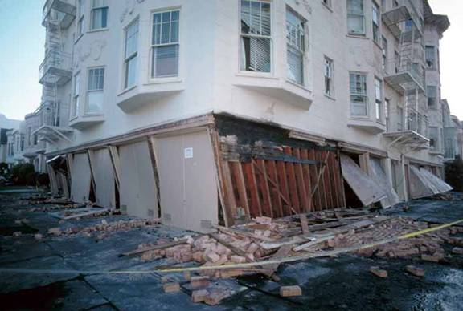
Rayleigh Wave Phase Velocity Model
Solve for periods between 2 and 10 seconds
Model parameters in x, y, and frequency.
frequency ≈ depth for surface waves
Non-linear inverse problem with normalization to impose a priori constraint on model roughness.

Slide 29
Tomography
Extract Rayleigh waves from station pairs
Calculate Rayleigh wave phase velocity model using measurements from station pairs
Calculate Shear wave velocity model from the phase velocity model

Slide 30
Shear Wave Velocity Model
Solve for 3D shear wave velocity structure
Best observations 250m - 5km
Non-linear inverse problem with normalization to impose a priori constraint on model roughness.

Slide 31
Resolution – Period 2s

Slide 32
Resolution – Period 3s

Slide 33
Resolution – Period 4s

Slide 34
Shear Wave Velocity Comparison

Slide 35
Outline
Motivation and Background
Seattle’s Geologic Setting
Seismic Tomography
Predictions
Main Points

Slide 36
Crustal Events
10 km deep
Thrust events
East-West strike
Dipping 45°
6.0 Moment Magnitude
Bandpass filter 0.5-1 Hz

Slide 37
Crust North
My Model
Stephenson Model

Slide 38
Crust North - Ratio

Slide 39
Crust South
My Model
Stephenson Model

Slide 40
Crust South - Ratio

Slide 41
Crust West
My Model
Stephenson Model

Slide 42
Crust West - Ratio

Slide 43
Crust East
My Model
Stephenson Model

Slide 44
Crust East - Ratio

Slide 45
Benioff Zone Earthquakes
Depths 43 km, 51 km, and 51 km.
Same source as 2001 Nisqually 6.8 event.
Bandpass filter 0.5-1 Hz

Slide 46
Benioff Zone Earthquakes

Slide 47
Benioff Zone West
My Model
Stephenson Model

Slide 48
Benioff Zone West - Ratio

Slide 49
Benioff Zone Central
My Model
Stephenson Model

Slide 50
Benioff Zone Central - Ratio

Slide 51
Benioff Zone East
My Model
Stephenson Model

Slide 52
Benioff Zone East - Ratio

Slide 53
Simulations – Average Ratios
Crust
Benioff Zone

Slide 54
Main Points
I presented a new shear wave velocity model of the Seattle Basin determined with direct observations.
The new model shows improvements in predictions of ground motions for two local events.
Simulations of synthetic events predict the amplification pattern within Seattle for a collection of crustal and Benioff earthquakes.
The model predicts regions of increased and reduced risk relative to the Stephenson model.

Slide 55
Thank You!

Slide 56
Seattle sits on a sedimentary basin
http://geomaps.wr.usgs.gov/pacnw/jello/3DL.gif

Slide 57
Amplified shaking during earthquakes Tokyo - 2004 Chuetsu 6.6
Furmura and Hayakawa [2007]

Slide 58
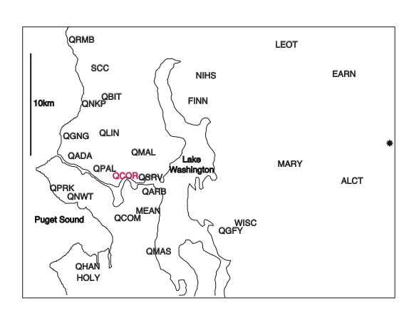
Amplitude Comparisons

Slide 59
Two Local Earthquakes

Slide 60
Amplitude Comparisons
Earthquake Depth = 6 km
Earthquake Depth = 58 km

Slide 61
What Next?

Slide 62
Improved Seismic Hazard Assessment for Seattle
Earthquake Scenarios
Regional Velocity Model
Basin Velocity Model
Site response
Non-linear response
Earthquake Simulations
u_{rock}
A_{3D}
A_{site}
A_{non-linear}

Slide 63
Model Validation
Validate the new velocity model by comparing simulations calculated using finite difference code to observations of recorded earthquakes.
Inputs:
Event Focal Mechanism
Event Hypocenter
Source-Time Function
Velocity Model
Station Locations
Output:
Synthetic seismograms at each station location

Slide 64
Carnation Event Scatter

Slide 65
Kingston Event Scatter

Slide 66
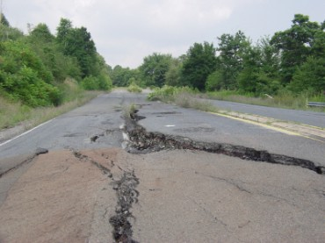
Run Simulations on Synthetic Events
Calculate the following probability:

Slide 67
A_{3D}

Slide 68
Earthquake Simulations
Frankel et al., [2006]

Slide 69
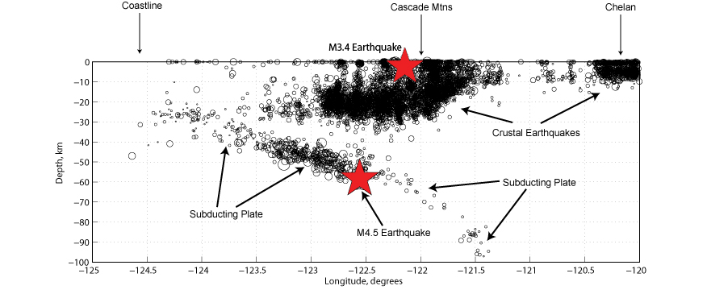
Benioff Zone Simulations

Slide 70
Seattle Fault Simulation
Asperities
Rupture Time Progress

Slide 71
Seattle Fault Simulation

Slide 72
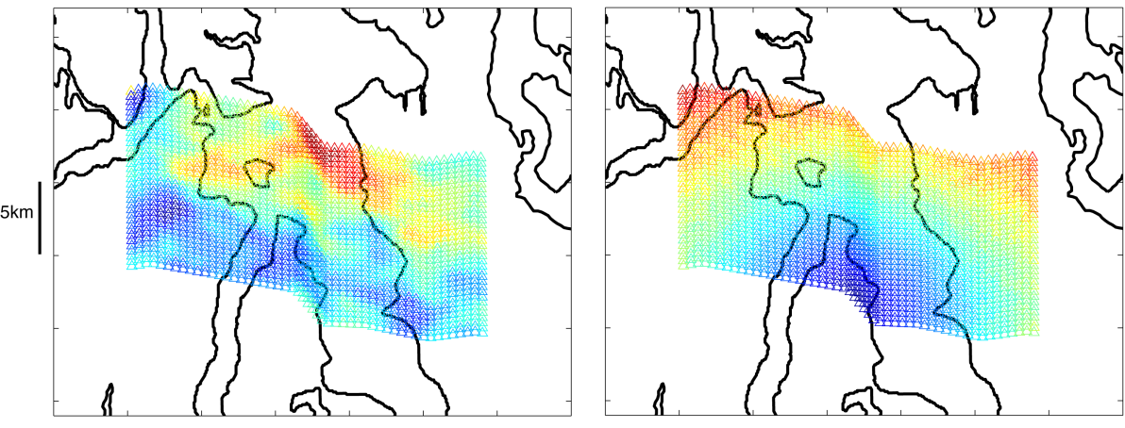
Peak Ground Velocity

Slide 73
Observations of Basin Amplification 2002 Denali 7.9
Barberopoulou et al., [2004]

Slide 74
Step 2 - Forward Problem
Calculate Rayleigh wave dispersion curve from a 1-D shear wave velocity model
Represent traveling waves as a sum of standing waves (normal modes), Takeuchi and Saito [1972]

