Slide 1
Integrated Analyses for Monitoring and Rapid Source Modeling of Earthquakes and Tsunamis
Brendan Crowell
Subduction Zone Observatory Seminar
May 13, 2015

Slide 2
Takeaway message:
More data is never a bad thing!

Slide 3
Data Types for Real-Time Earthquake and Tsunami Monitoring
Geodetic:
GNSS (GPS, Galileo, GLONASS, Beidou)
Static offsets
Dynamic motions
Derivative products (ionospheric perturbations, precipitable water)
Strainmeters (Borehole, laser, creepmeters to a lesser extent)
Tiltmeters
Gravimeters
Ocean bottom pressure
Seafloor GNSS with wave gliders
Seismic:
Land-based strong-motion and broadband
OBS through cabled array
Seismogeodetic displacements and velocities (GNSS+seismic through
Kalman filter)
Other:
Tide gauges
Buoys

Slide 4
Applications of Different Data Types
Earthquake Early Warning and Rapid Hazard Assessment
P-wave displacement and frequency measurements (a few seconds)
land-based seismic and OBS (Magnitude between 2 and ~8)
seismogeodetic displacements (Magnitude > 5)
S-wave approaches (20 seconds to a minute)
GNSS displacements (seismogeodetic or otherwise; M>5)
land-based seismic and OBS
borehole strainmeters (lowers geodetic magnitude floor)
Finite fault source modeling (several minutes)
GNSS static offsets, kinematic inversions
Seafloor GNSS (static offsets only)
tiltmeters
Ocean bottom pressure (> several minutes)
W-phase (minimum 8 degree source-receiver distance)
regional seismic networks
Tsunami Early Warning (minutes to tens of minutes to hours)
Near-field – Forward modeled sources from
GNSS static offsets, kinematic inversions
Ocean bottom pressure
Tide Gauges
Basin Wide
Dart Buoys
Ionospheric tracking from GNSS phase observables
Gravity perturbations (if lucky, GRACE)

Slide 5
Overarching Theme: Different Data is Sensitive to Different Things
Geodetic:
GNSS: non-inertial displacements, low frequency sensitivity
Strainmeters: orientation of deformation, sensitive to low and high frequencies
Tiltmeters: Gradient of deformation (i.e. strain) in vertical, depth of deformation
Gravimeters: mass changes
Ocean bottom pressure: integrated water column changes
Seafloor GNSS with wave gliders: proximity to sources
InSAR, LIDAR, photogrammetry: high resolution deformation patterns
Seismic:
Land-based strong-motion and broadband: low noise, high frequency sensitivity
OBS: proximity to sources
Seismogeodetic: non-inertial displacements with sensitivity to both high and low frequencies
Other:
Tide gauges: coastal sea level
Buoys: regional sea level

Slide 6
Kobayashi et al. [2006] – 2005 Mw 7.0 Fukuoka Prefecture Earthquake
High-rate GPS inversion indicated more shallow slip under the area of maximum damage than the strong-motion inversion
Joint inversion was able to capture both the shallow and deep behavior

Slide 7
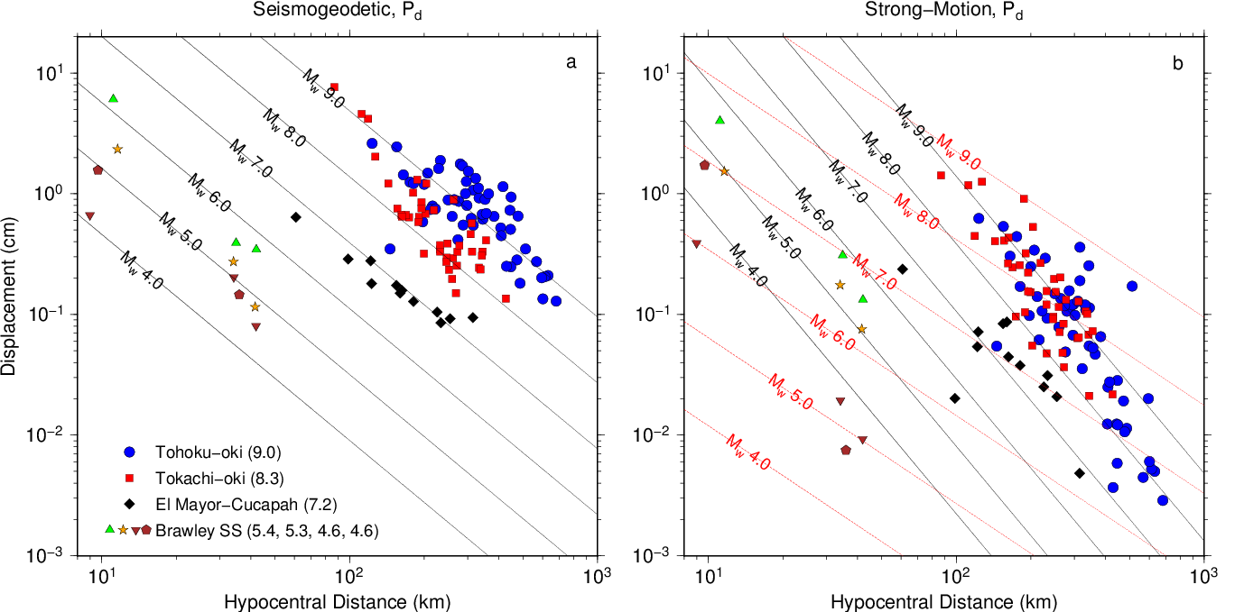
Earthquake Early Warning Pd Scaling of Seismogeodesy vs. Strong-Motion for Large Earthquakes
Pd is the peak displacement during the first 5 seconds after the P-wave arrival – ElarmS relies on the scaling between Pd and distance from the earthquake to determine magnitude
For large events, Pd calculations from strong-motion recordings saturate. Seismogeodetic displacements do no saturate due to low-frequency sensitivity
Crowell et al. [2013]
Notes:
Here are the results for Pd scaling using seismogeodetic data on the left and strong-motion data on the right using seven different earthquakes. Now, the three largest earthquakes have differentiated each other in the seismogeodetic data and there is no saturation on the upper end. The accelerometer scaling is starting to differentiate, but there is still significant overlap. The lack of saturation hints at possible deterministic earthquake rupture, that is, do earthquakes know how large they will be when they start. It is a contentious issue, but this relationship shows great promise given the limited number of earthquakes in this study. Also note where the normal real-time GPS detection limit would be and where the seismogeodetic detection limit is. Using seismogeodesy allows for recording displacements at the sub-mm level whereas RTGPS is at the cm level, making relationships like this possible.

Slide 8
PBO Borehole Strainmeter Applicability to Early Warning

Slide 9
Melgar et al. [2013] – A systematic difference between source models using static offsets from GPS versus seismogeodesy

Slide 10
Koketsu et al. [2011] – Tohoku-oki earthquake

Slide 11
Koketsu et al. [2011] – Tohoku-oki earthquake

Slide 12
Koketsu et al. [2011] – Joint Inversion captures the seafloor geodetic observations

Slide 13
Melgar and Bock [2014] –Static GPS and Ocean Based Instrumentation

Slide 14
Melgar and Bock [2014] –Static GPS and Ocean Based Instrumentation – Tsunami Predictions

Slide 15
Melgar and Bock[2015] –Kinematic land versus Kinematic Land+Ocean Based Instrumentation
Figures 4 and 7

Slide 16
Melgar and Bock[2015] – Maximum Tsunami Amplitude for an Different Inversions
Figure 10

Slide 17
Melgar and Bock[2015] – Static, Kinematic, Ocean Based Instrumentation
Figure 11

Slide 18
Melgar and Bock[2015] – Resolution Tests of different models
Figure 15

Slide 19
Absolute Pressure Gauge functions as Strong-Motion Sensor
From Diego Melgar

Slide 20
Rabble Points
What data source provides the best return on investment? What shouldn’t we spend money on ever again?
If we only installed one instrument, what would enhance our understanding of the seismic process in subduction zones the most and where should it be located?
What other subduction zone processes or studies would be benefitted by these data sources?
How can other data sources aid in rapid hazard assessments?
Should real-time telemetered data be a priority in a subduction zone observatory?

