Slide 1
“Possibilities for offshore geodesy”
Questions of importance for understanding S.Z. deformation offshore and tools that might be applied to address them.
April 15th, 2015

Slide 2
Characterizing deformation offshore – necessary for answering questions about anticipated seismogenic portion of plate boundary at Cascadia
Slip Rate
Deficit
(cm/yr)
4
3
(Safer and Tobin, 2011)
2
1
Most/all (?) of the interseismically locked portion of the subduction zone is west of the coast in Cascadia
0

Slide 3
During the interseismic period -
What is the spatial distribution of plate locking behavior – particularly within the shallow portion of the plate interface?
Relevant for:
Anticipating magnitude and location of future megathrust ruptures and proximity of strong ground shaking near the coast.
Identifying possible segment boundaries (see number 1)
Characterizing the shallow extent of strong plate locking, and using that to inform models of shallow slip
Linking seismicity observations with plate slip behavior

Slide 4
An example from Alaska -

Slide 5
During the interseismic period -
Are there temporal changes in slip behavior within the seismogenic portion of the plate boundary?
Is there evidence for transient (aseismic) slip events (during the interseismic period) that are geodetically observable up-dip of the deep frictional transition zone?
Up-dip of the locked zone? Accompanied by tremor or earthquakes?
Relevant for:
Characterizing heterogeneous rheology on the plate interface (Helps to anticipate co-seismic slip behavior as well)
Interpretations of seismic observations, or future plans for seismic instrument deployments.

Slide 6
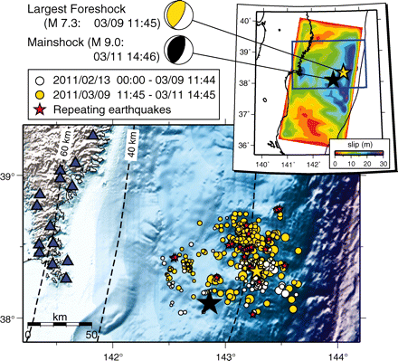
Example of & premonitory slip in Japan:
Kato et al. (2012)

Slide 7
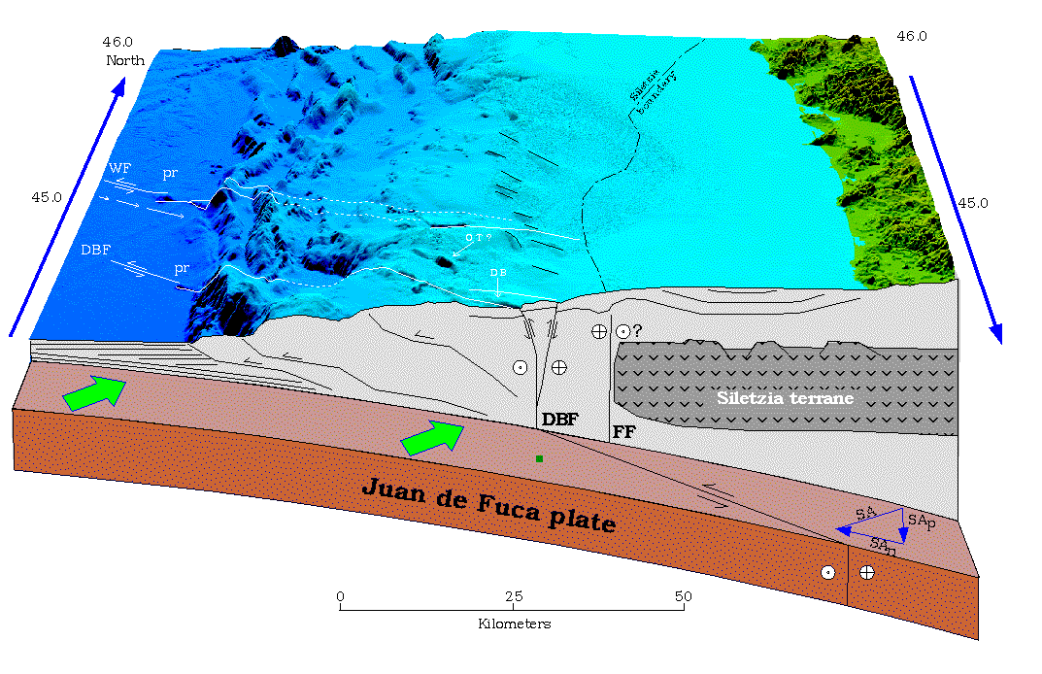
During the interseismic or coseismic period -
How is strain (particularly oblique slip) partitioned and what is the mode of failure within the accretionary prism?
Relevant for:
Understanding how the prism is constructed and deformed.
Identifying prevalence of elastic versus plastic processes.
Relating porous flow and pore pressure conditions through the prism with failure modes on structures.
Goldfinger et al. (1997)

Slide 8
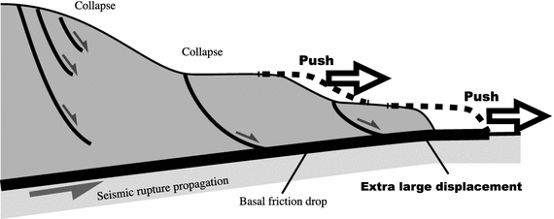
… and building on potential insight from geodetic AND seismic AND geologic insight:
How will the mechanical/frictional properties of the prism (particularly shallow) influence shallow coseismic slip magnitude?
Kawamura et al. (2012)

Slide 9
… and building on potential insight from geodetic AND seismic AND geologic insight:
Could more detailed information about slip behavior help us to link prism structure with mechanical properties of the subduction zone?

Slide 10
Seafloor geodetic measurements used to observe interseismic locking behavior at Peru-Chili trench, specific focus is near the trench.
Relies on Acoustic-GPS at two stations, in 2001 and 2003 (reoccupying installed benchmarks)
Used observations to determine no-slip on the plate interface between 2-40 km depth.
Seafloor geodetic measurements used to observe coseismic slip behavior at Japan trench – focus on frontal wedge.
Uses pressure sensors (on OBS; drift rate of 0.3 hPa/day) for vertical displacement, and surveying (acoustic ranging; +/- 20 m) of benchmarks.
Used observations to determine uplift of 5 m and horizontal displ. Of 60-70 m (+/- 20 m) along frontal wedge.
Horizontal displacements compare to acoustic/GPS stations Sato et al. 2011 (error of 50-60 cm) landward – showing ~30 m horizontal displ. – implies large offset along normal fault, and large displacement within shallow fault

Slide 11
Gagnon et al. 2005

Slide 12
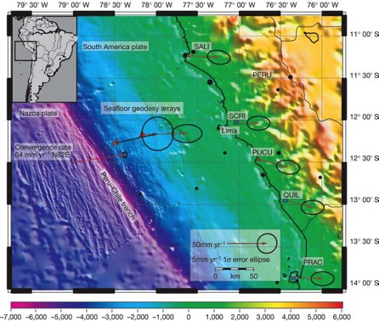
Gagnon et al. 2005
The REVEL plate convergence vector (64mmyr at N 82 E) is shown
relative to stable South America. Vector solutions for Nazca convergence, temporary land stations and transponder arrays are shown relative to stable South America through the use of ITRF00 (ref. 25).
Models of surface deformation and plate organization. a, Modellng surface deformation: 3D-def model of the surface expression of a no-slip condition between the
Nazca and South America plates. The onset of the no-slip zone was successively lowered
from the trench to 10 km depth. Asterisk, model uses the convergence vector from ref. 20.
Double asterisk, model uses a steeper dip. b, Plate organization: trench perpendicular
profile from the Nazca to the South America plate around 128 S. Topography combines
multibeam sonar and satellite altimetry data. Displacement (and 1ϕ errors)
perpendicular to the trench relative to stable South America are shown as triangles for
temporary land stations and transponder arrays, and squares for land stations from ref. 8.
letters to nature

Slide 13
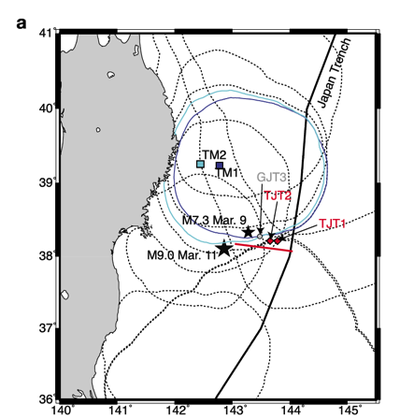
Ito et al., 2011
Time series of observed bottom pressures at
TJT1. (top) Bottom pressures from April, 2010 to the end
of March, 2011. (bottom) Enlargement of the interval
between 7 March and 16 March, 2011. Red lines represent
observed bottom pressures after the removal of ocean tide
effects. Relative variations in pressure (hPa) correspond to
relative vertical displacements (cm).

Slide 14
Ito et al., 2011
Two‐ dimensional fault model in the cross section
perpendicular to the trench axis. The red line indicates
the plate boundary assumed in a two‐ dimensional elastic
half‐ space, where the geometry of the plate boundary is
taken from seismic reflection and refraction images [Tsuji
et al. , 2011]. The surface of the elastic half‐ space dips 6°
seaward because of the steep bathymetry around the
observation sites.
(b) Comparison between observed and
predicted vertical displacements.
(c) Comparison between observed and predicted horizontal displacements.
Diamonds indicate the observed displacement; red curves indicate predicted displacements. Error bars around the diamonds indicate the observation error. The predicted displacement was derived from a fitted fault model with slip magnitudes of 80 m, where the updip end of the suitable fault reached the surface.
(d) Pre‐ existing seismic structure and observed
deformation of the frontal wedge. The seismic structure is
modified from Tsuji et al. [2011]. Red arrows indicated the
observed displacements at TJT1, TJT2, and GJT3. The red
line indicates the fault model estimated in this study.

Slide 15
Following slides are possibilities to use to supplement discussion on techniques

Slide 16
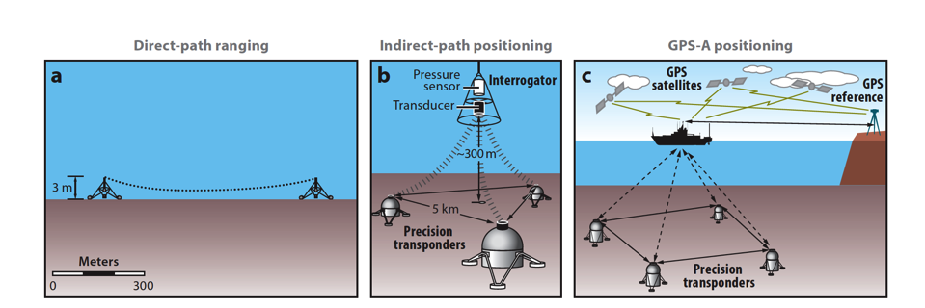
GPS - Acoustic
Burgmann & Chadwell, 2014
Seafloor Pressure

Slide 17
Burgmann & Chadwell, 2014; modified from Fujiwara et al. 2011, Ito
et al. 2011, Kodaira et al. 2012
Differenced bathymetry

Slide 18
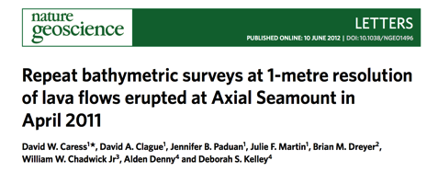
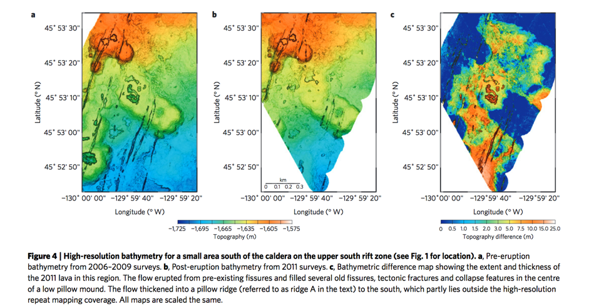

Slide 19
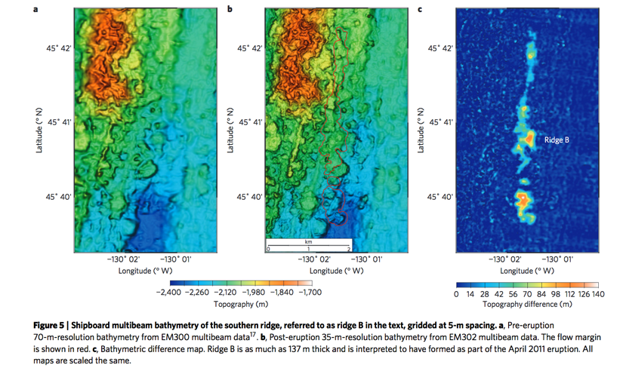

Slide 20
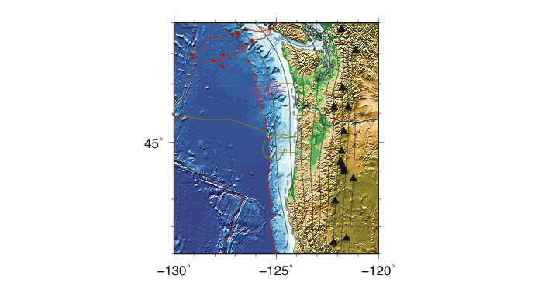

Slide 21
Burgmann & Chadwell, 2014
Seafloor geodetic measurements of plate motion, mid-ocean ridge spreading, and subduction-related deformation of the Juan de Fuca
plate. (a) Map of existing and in-progress measurements. Three GPS-A velocities (red arrows) are compared with geologic plate motion
of the Juan de Fuca plate with respect to stable North America (Wilson 1993) (black arrows). Northeast-directed GPS velocities along
the coast (blue arrows) reflect the broad interseismic elastic strain accumulation across the Cascadia subduction zone (McCaffrey et al.
2013). Red and orange squares are recently funded and proposed GPS-A profiles, respectively, across the locked subduction thrust. Red
triangles are existing Ocean Drilling Program boreholes instrumented with formation and seafloor pressure sensors (Davis et al. 2004),
and red circles are seafloor pressure sensors, on or near the NEPTUNE Canada cable (red line) (E. Davis, personal communication). A
borehole tiltmeter, seafloor geodetic benchmarks, and a pressure-sensor array (orange circles) are to contribute additional data in real
time via the Canadian cable system (red line) ( J. McGuire, personal communication). Orange triangles mark nodes instrumented with
pressure sensors of a new seafloor cable system off Oregon ( green line; Ocean Observatories Initiative Regional Scale Nodes). Purple
dots are M >3 earthquakes, dark yellow lines are spreading ridges, and orange lines are oceanic transform faults.

Slide 22
Burgmann & Chadwell, 2014

