Slide 1
Seafloor Drilling for Subduction Zone Science
Informal Report from the recent Cascadia Seafloor Drilling Meeting
Deep Sea Drilling Project (1968-1983)
Ocean Drilling Program (1984-2003)
Integrated Ocean Drilling Program (2004-2013)
International Ocean Discovery Program (2013-)

Slide 2
Outline
Scientific Drilling Capabilities
Borehole Seismology
Borehole Hydrology & Geodetic Monitoring
  Motivation
  CORK Observatories
  Examples
    Juan de Fuca Plate
    Nankai
    Costa Rica
Drilling for Geodynamic Monitoring in Cascadia
I am not an expert so I have borrowed shamelessly from others

Slide 3
IODP Science Themes
The deep biosphere and the subseafloor ocean.
Environmental change, processes and effects.
Solid earth cycles and geodynamics.

Slide 4
from Keir Becker presentation at 2015 Cascadia Drilling Workshop

Slide 5
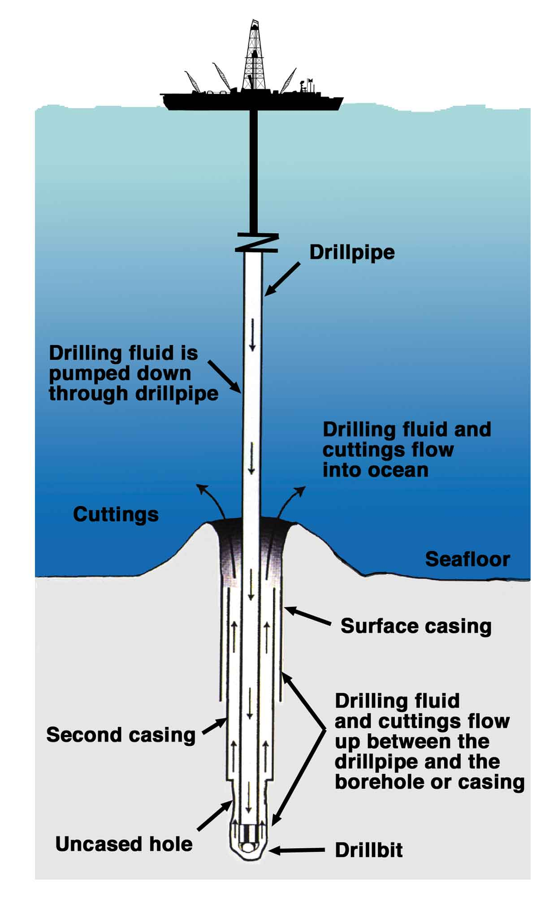
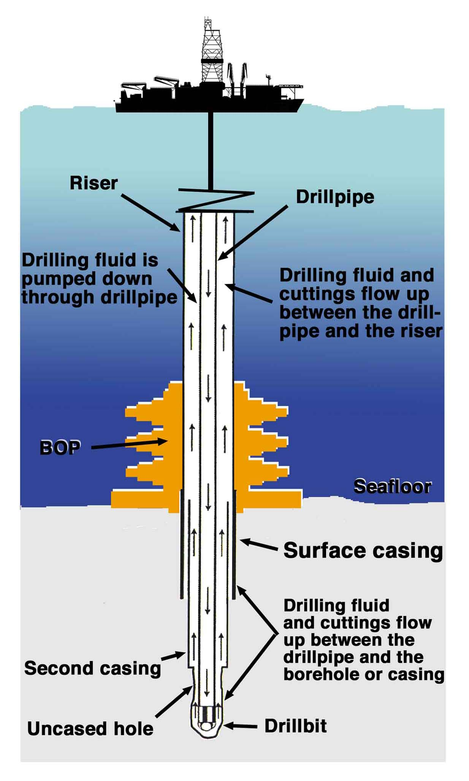
Riserless Drilling
JOIDES Resolution
Riser Drilling
CHIKYU
from Keir Becker presentation at 2015 Cascadia Drilling Workshop

Slide 6
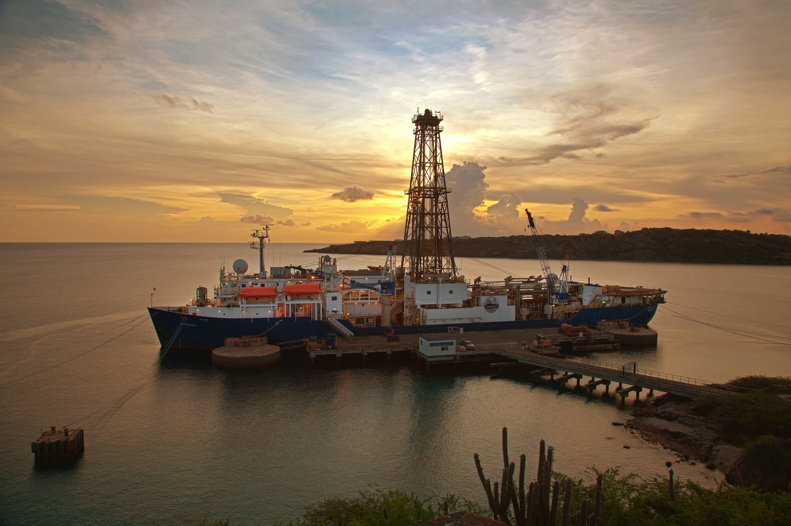
JOIDES Resolution
from Keir Becker presentation at 2015 Cascadia Drilling Workshop
Curaçao, 2011

Slide 7
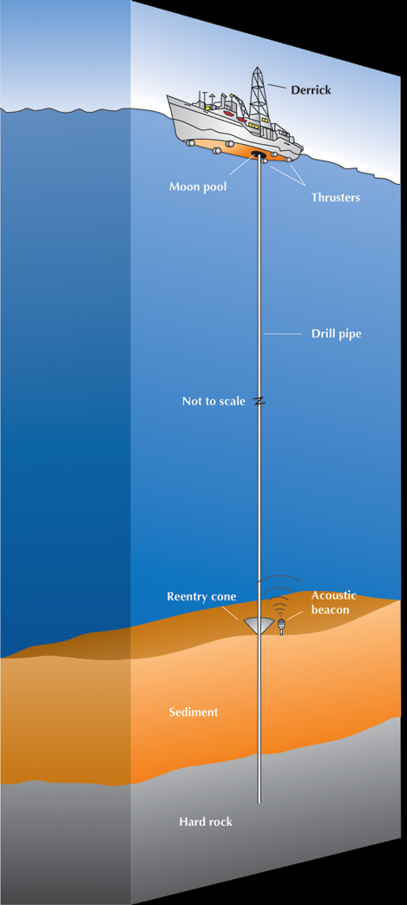


JR Facts
Built in 1978 (Sedco/BP471)
  Converted for scientific research 1985
  Major renovation completed 2009
Owned: Overseas Drilling Limited, Inc., Siem Offshore
Length: 143 m (471 ft)
Dynamic positioning
  12 thrusters: 10 retract, 2 fixed
Shipboard complement
  ~65 crew (marine, drilling, engineering, electrical, catering)
  ~60 IODP (scientists, lab technicians, operations/engineers, education/outreach)
$12M for a 2-month leg (4 per year)
Modified from Keir Becker presentation at 2015 Cascadia Drilling Workshop

Slide 8
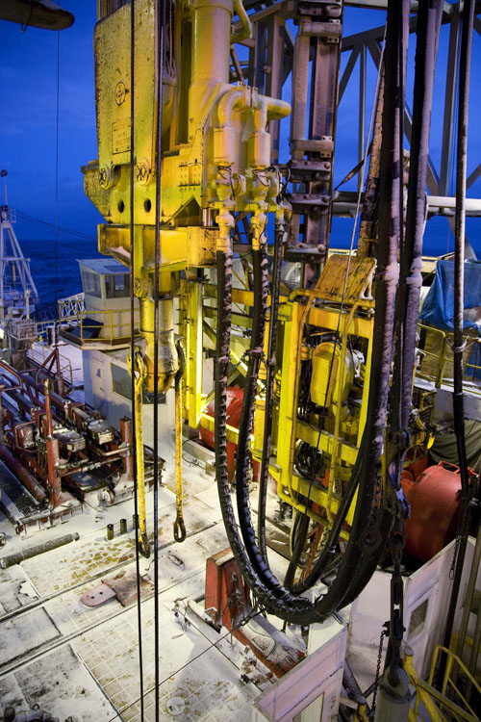
JR Operational Capabilities
Penetration Records
  2111 m, Costa Rica Rift (Hole 504B), ~1 yr (hard rock)
  1927 m, Canterbury Basin (Hole U1352), 15 d (sediments)
Deepest Water
  5968 m, Mariana Basin (Hole 802A)
  String lengths >6000 m require drill string stress assessment
  6919 m: longest drill string (Hole 756D: 5724 m water, 1195 m penetration)
Shallow Water
  Shallow water limit >75 m water
  Operational limits on environmental conditions <650 m water
from Keir Becker presentation at 2015 Cascadia Drilling Workshop
Notes:
504B mostly hardrock
1352: clastic seds, no casing
802 went to 560 mbsf

Slide 9
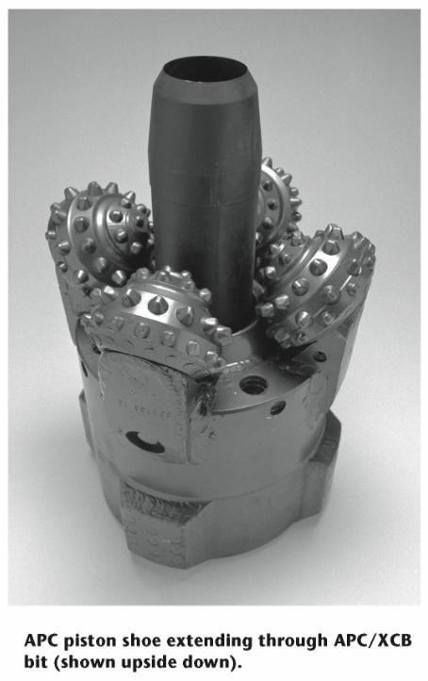
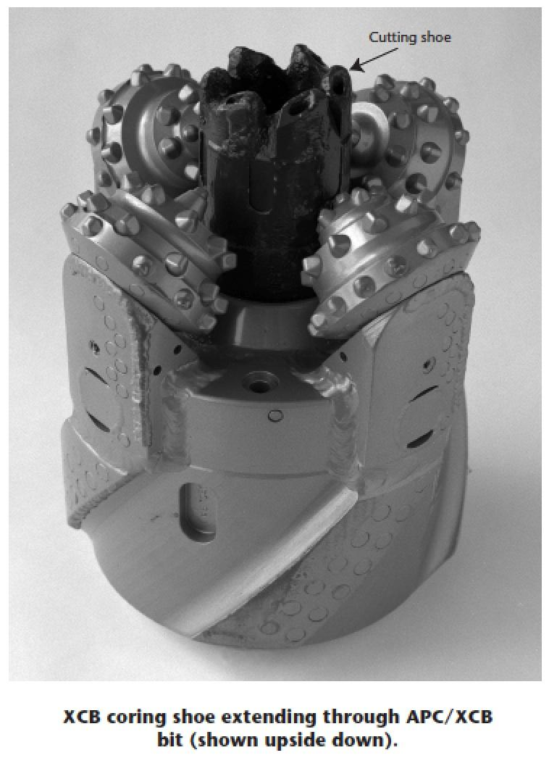
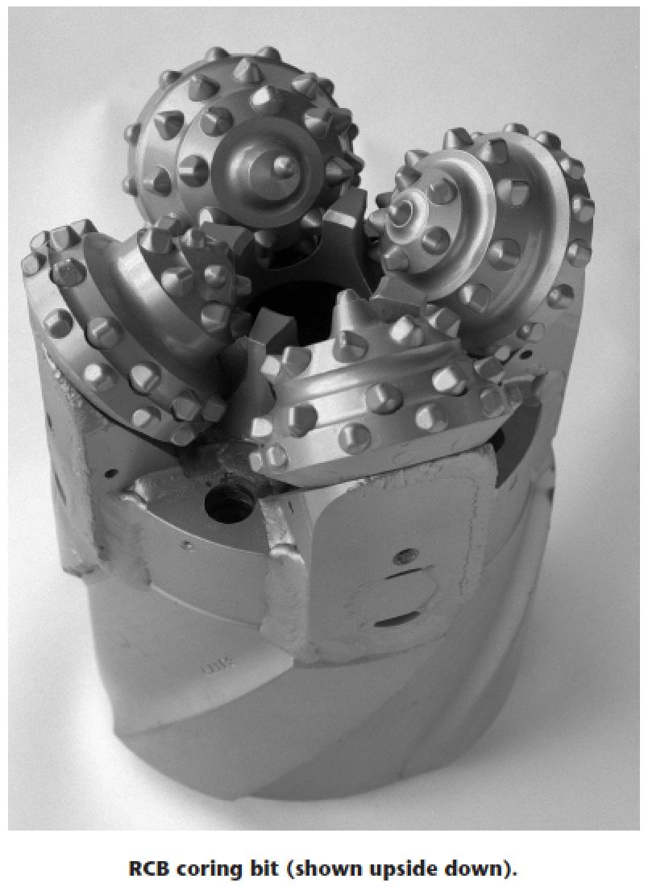
JR Coring Capabilities
Advanced Piston Corer (APC)
High quality cores with high recovery in soft to firm sediments (record = 490 mbsf)
Extended Core Barrel (XCB)
Moderately lithified sediments (APC refusal to ~800-1000 m). Variable recovery rates. Non-rotating core barrel to minimize disturbance
Rotary Core Barrel (RCB)
Lithified sedimentary, igneous, and metamorphic rocks. Bit and core barrel are rotated with drill string
Modified from Keir Becker presentation at 2015 Cascadia Drilling Workshop

Slide 10
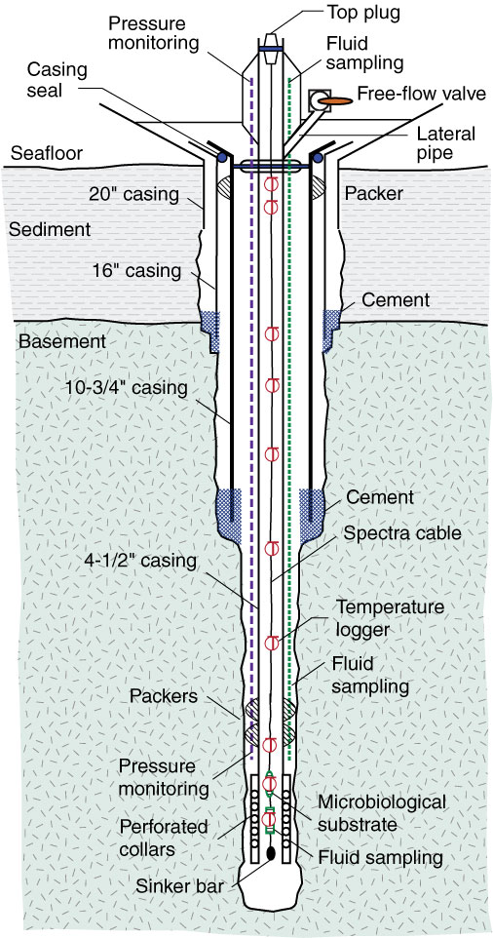
Reentry Capabilities
Free-Fall Funnel
  Free falls around drilling string and darts into the sediment
  Allows temporary reentry for bit changes
Re-entry Cone and Casing System
  Permanent installation
  Capable of supporting up to 4 casing strings using a casing hangar system
  Seals off unstable sections of borehole to allow deeper penetration
  Framework for long-term borehole observatories (CORKs)
from Keir Becker presentation at 2015 Cascadia Drilling Workshop

Slide 11
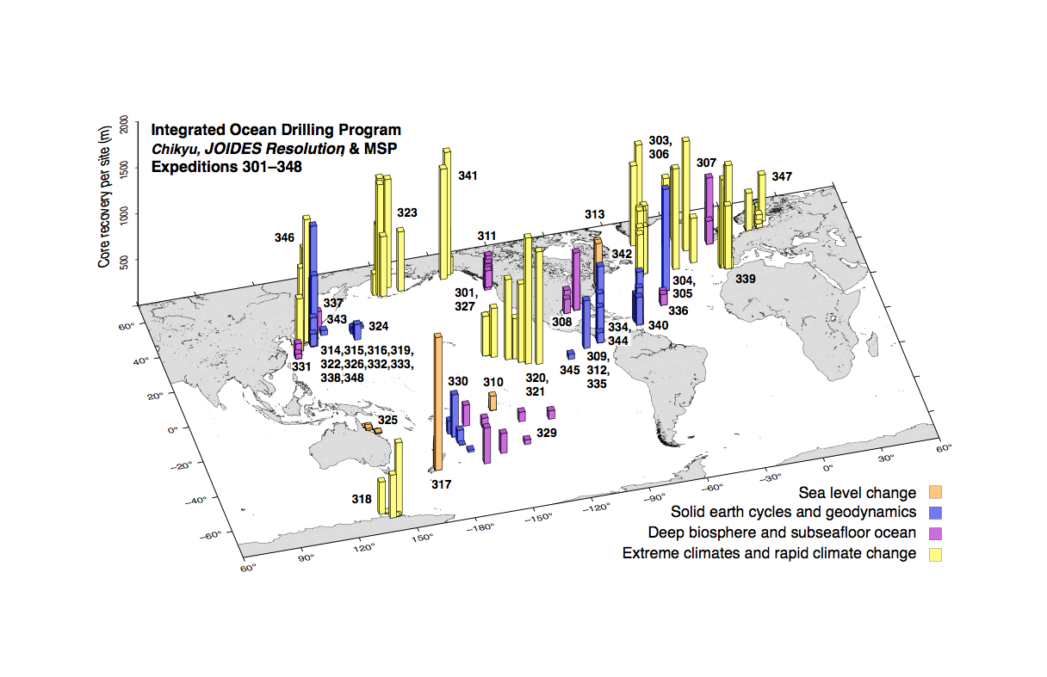
IODP-2 Region of JR Operations, 2013-2018
To be Fine-Tuned at May 12-13 JRFB
from Keir Becker presentation at 2015 Cascadia Drilling Workshop

Slide 12
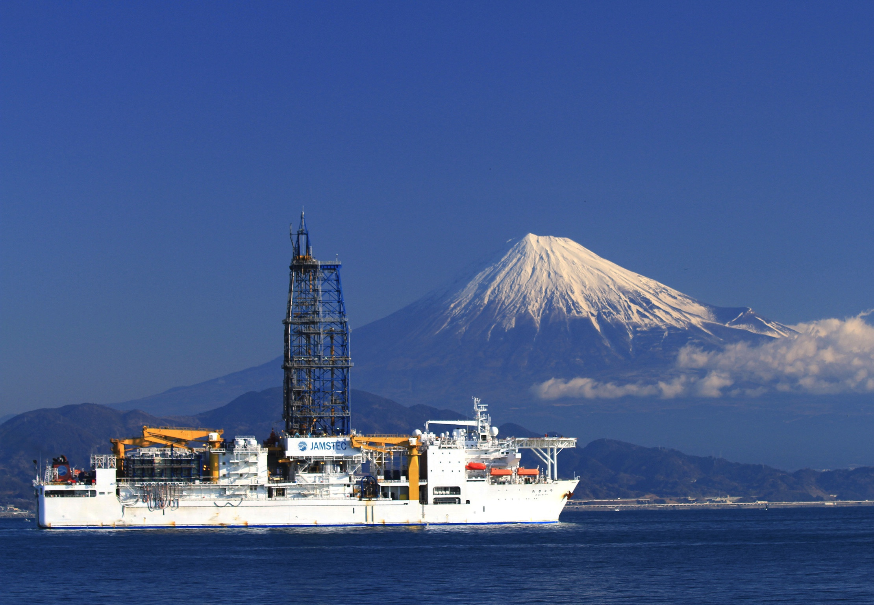
D/V CHIKYU
Courtesy Nobu Eguchi, JAMSTEC; Modified by KB
from Keir Becker presentation at 2015 Cascadia Drilling Workshop

Slide 13
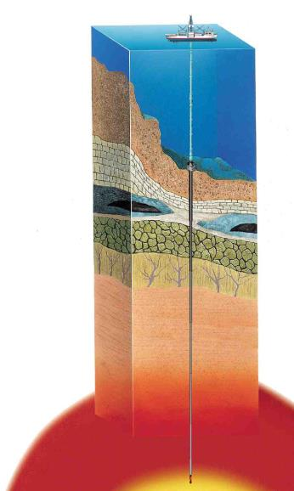
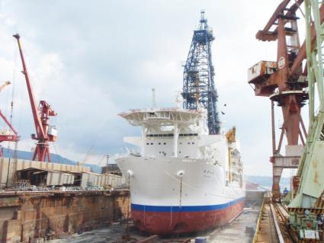
Present Drilling Capability
Water Depth
  Riser Drilling Max Water Depth (2500mWD)
    Deepest Riser Drilling:
      Kenya 2200mWD
      Nankai Japan 2054mWD
Total Depth (Water Depth + Penetration Depth)
  Max depth 9,000m from sea level
    Deepest Riserless Drilling:
      JFAST Off Sendai / 6897.5mWD (TD 7780.81mBRT)
2500mWD
9,000m from sea level
from Keir Becker presentation at 2015 Cascadia Drilling Workshop

Slide 14

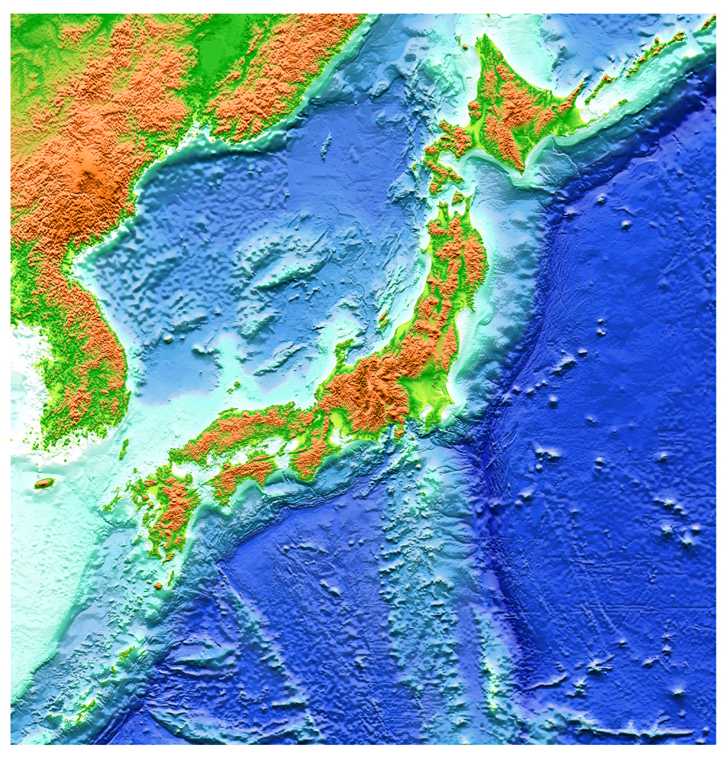
CHIKYU IODP Expeditions
CHIKYU IODP Expeditions
Drilled Site
Exp. 337 (Deep Coalbed Biosphere
Exp. 343 & 343T (JFAST)
Exps. 314, 315, 316, 319, 322, 326, 332, 333, 338, & 348 (NanTroSEIZE)
10-year+ backlog of projects
Unaffordable?
Exp. 331 (DEEP HOT BIOSPHERE)
Modified from Keir Becker presentation at 2015 Cascadia Drilling Workshop

Slide 15
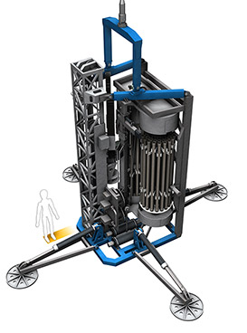
Robotic Seafloor Drill and Coring Systems
Able to work from vessels-of-opportunity
Utilize electro-optical-mechanical umbilical cable
De-coupled from ship and surface conditions
Coring & sampling to 100m+ in water depths of 2000-6000m
Capable of downhole in-situ measurements and instrument installation
Typically utilize rotary magazine
Use both rod and wireline techniques
Many systems including German MeBo used by IODP
from Tim McGinnis presentation at 2015 Cascadia Drilling Workshop

Slide 16
Outline
Scientific Drilling Capabilities
Borehole Seismology
Borehole Hydrology & Geodetic Monitoring
  Motivation
  CORK Observatories
  Examples
    Juan de Fuca Plate
    Nankai
    Costa Rica
Drilling for Geodynamic Monitoring in Cascadia

Slide 17
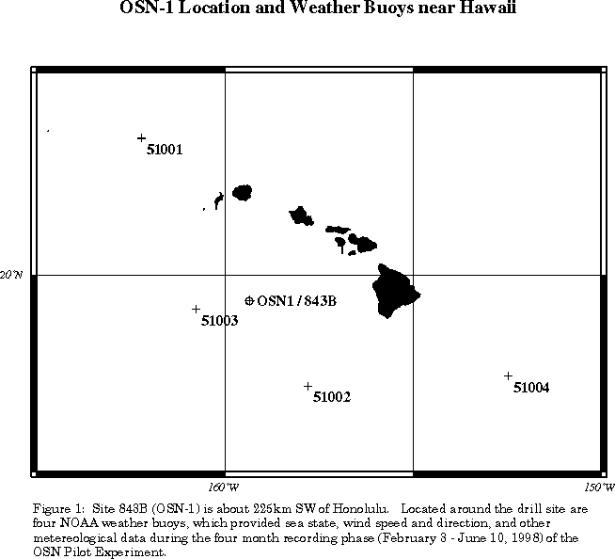
Ocean Seismic Network – 1 Pilot Experiment 1998
Deep Water (>4000 m)
Comparison of seafloor, buried and borehole seismometer
Stephen et al. (1999)

Slide 18
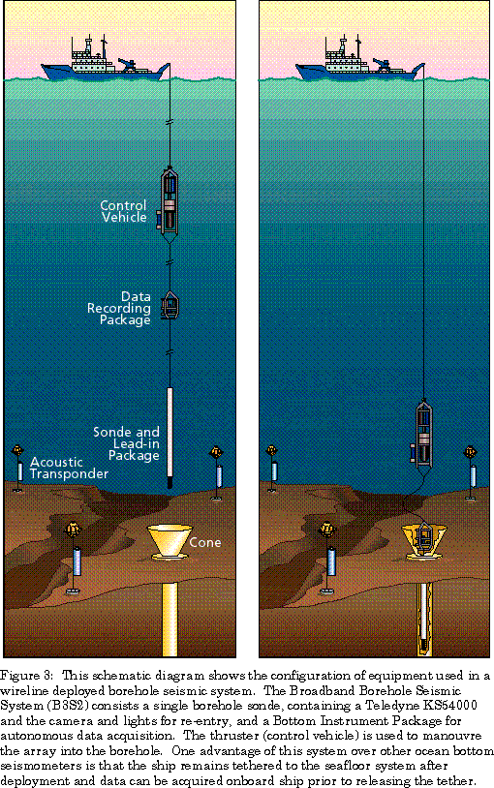
Deployment of Borehole Seismometer
Stephen et al. (1999)

Slide 19
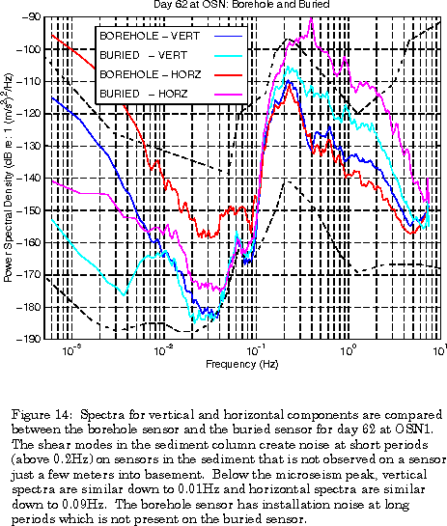
Stephen et al. (1999)

Slide 20
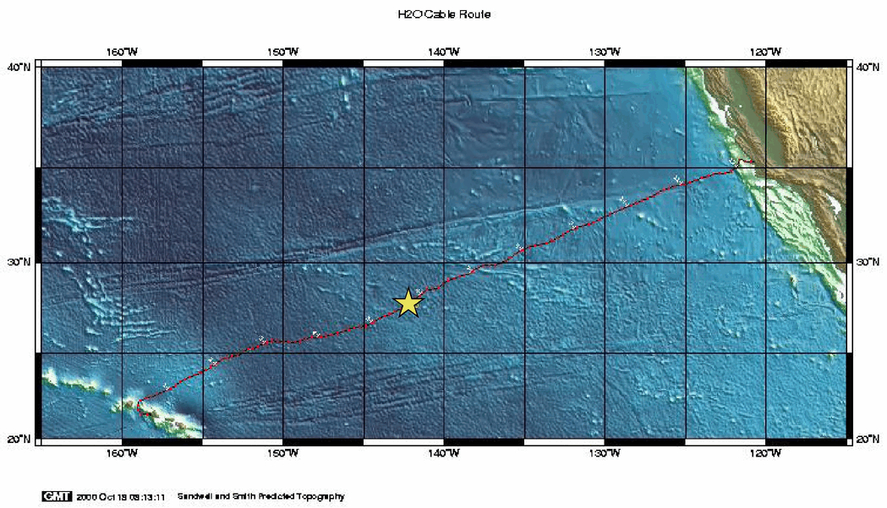
H2O Observatory 1998-2003
from H2O Observatory website at U. Hawaii

Slide 21
Outline
Scientific Drilling Capabilities
Borehole Seismology
Borehole Hydrology & Geodetic Monitoring
  Motivation (mine)
  CORK Observatories
  Examples
    Juan de Fuca Plate
    Nankai
    Costa Rica
Drilling for Geodynamic Monitoring in Cascadia

Slide 22
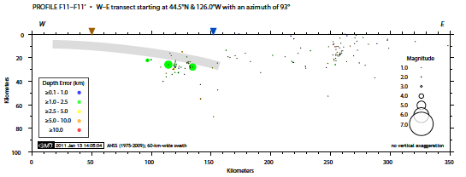
Oregon Profile – 44.5°N
coast
McCrory et al.
Notes:
Earthquakes largely absent on shallow megathrust

Slide 23
Three Models of Secular Strain in the Locked Zone
From David Schmidt
Models from David Schmidt

Slide 24
Horizontal Motions
Motivation for
GPS-Acoustic
Observations but no slow slip
Models from David Schmidt
From David Schmidt

Slide 25
Vertical Motions
Motivation for calibrated seafloor pressure observations (slow-slip without calibration)
Models from David Schmidt
From David Schmidt

Slide 26
Dilation (Volume Changes)
Motivation for
borehole observations
1 microstrain volumetric strain is ~10⁴ Pa (1 m of hydraulic head) in sealed sediments
Models from David Schmidt
From David Schmidt

Slide 27
Outline
Scientific Drilling Capabilities
Borehole Seismology
Borehole Hydrology & Geodetic Monitoring
  Motivation
  CORK Observatories
  Examples
    Juan de Fuca Plate
    Nankai
    Costa Rica
Drilling for Geodynamic Monitoring in Cascadia

Slide 28
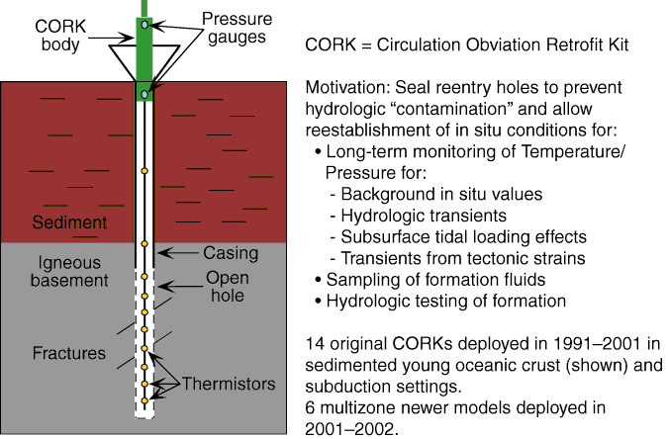
Becker and Davis (2005)

Slide 29
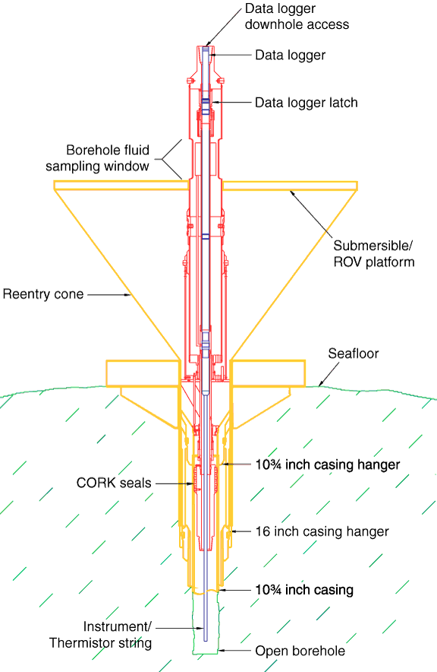
CORK
Becker and Davis (2005)

Slide 30
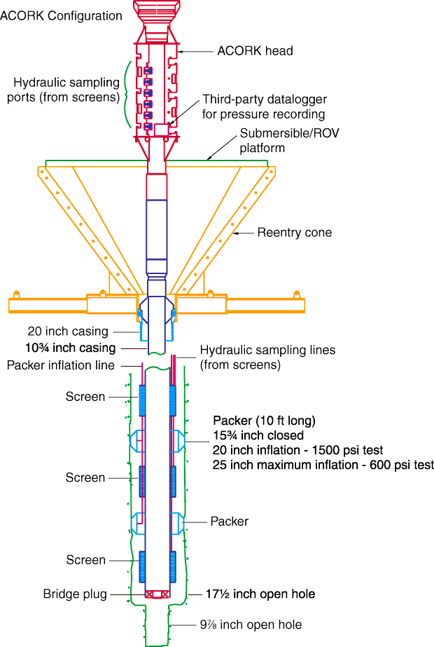
Advanced CORK - Nankai
Becker and Davis (2005)

Slide 31
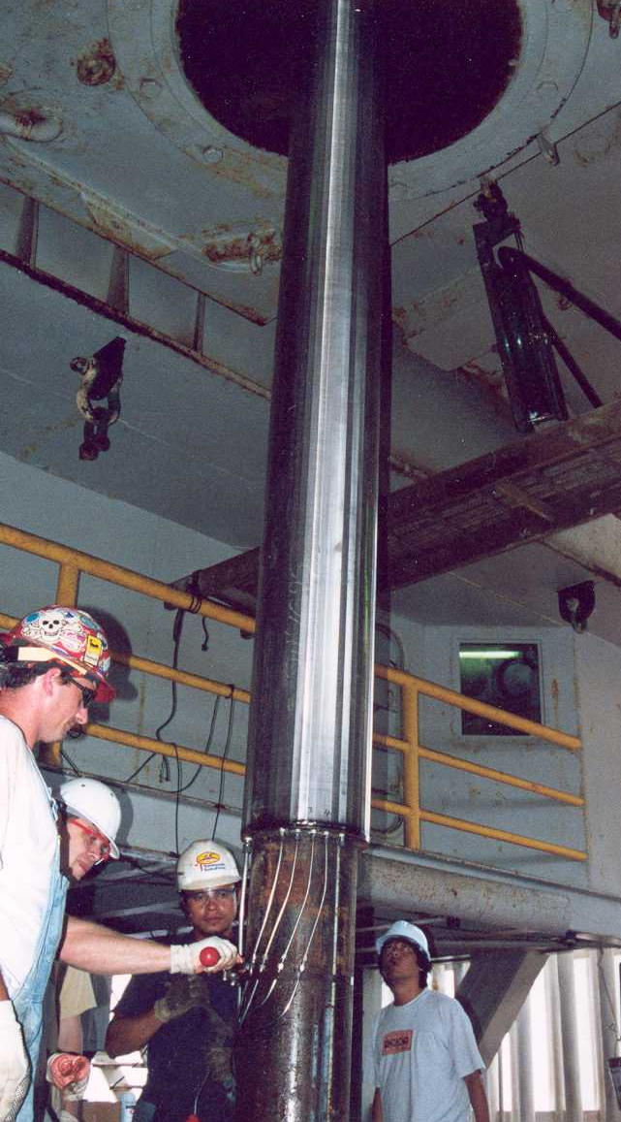
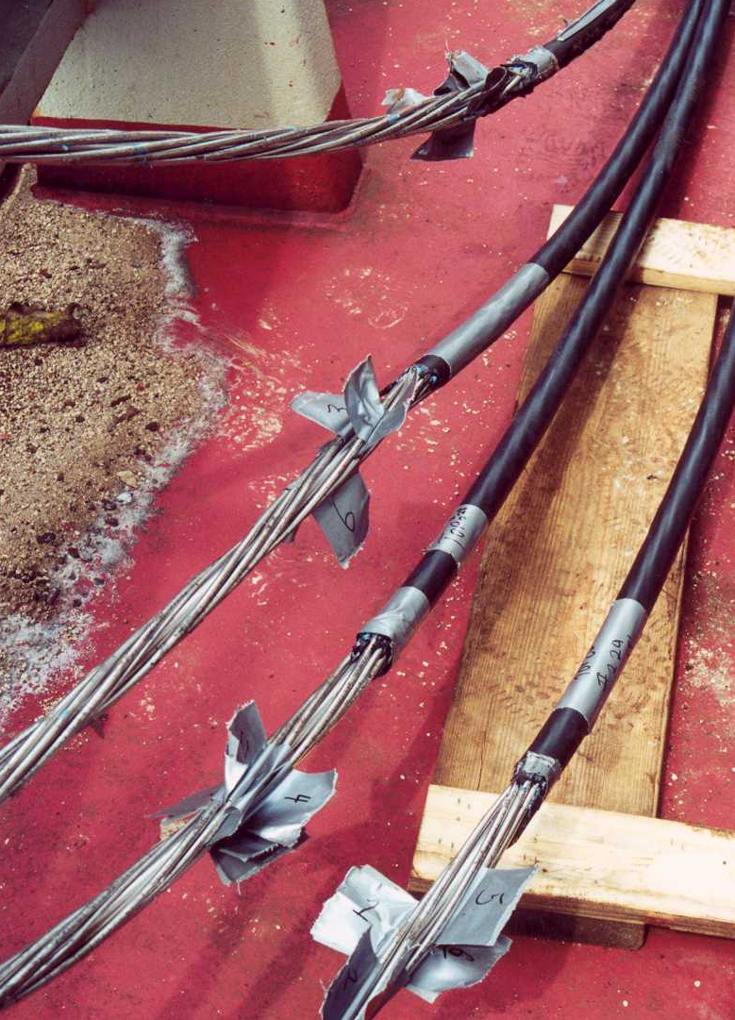
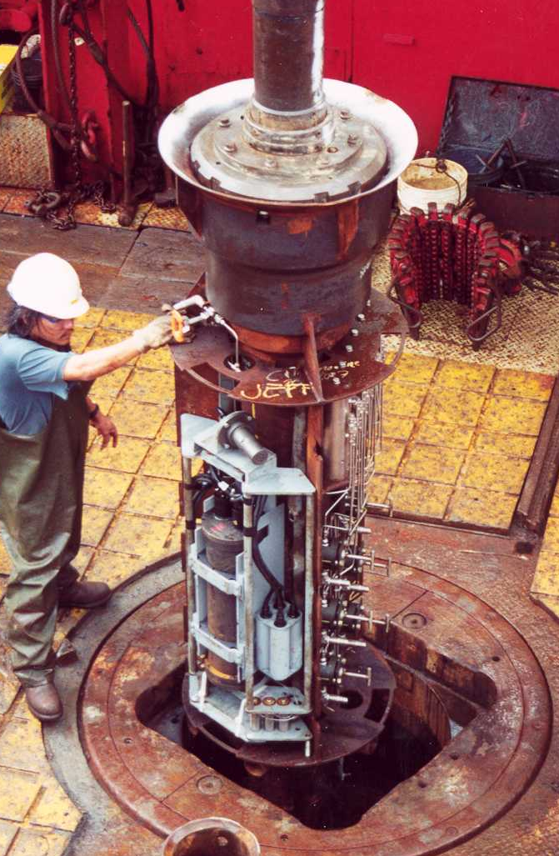
Typical components for pressure monitoring
Formation
screens
Wellhead
plumbing and
instrumentation
Hydraulic
umbilicals
from Earl Davis presentation at 2015 Cascadia Drilling Workshop

Slide 32
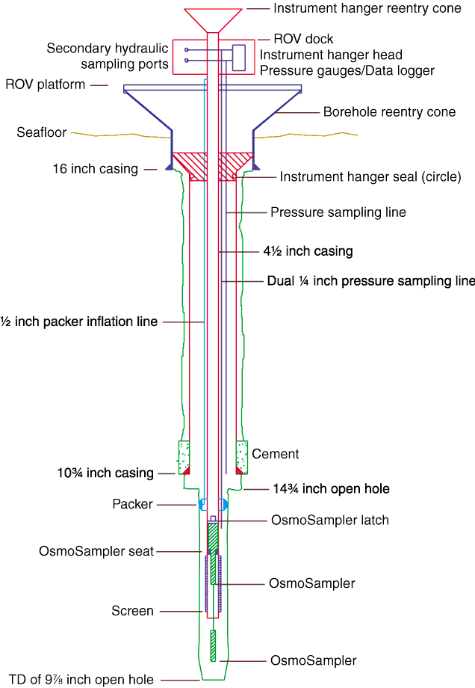
CORK-2 Costa Rica
Becker and Davis (2005)

Slide 33
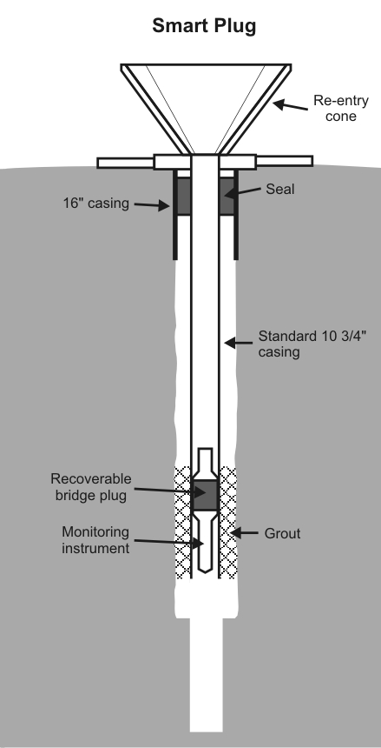
Smart Plug
Modified from Earl Davis presentation at 2015 Cascadia Drilling Workshop

Slide 34
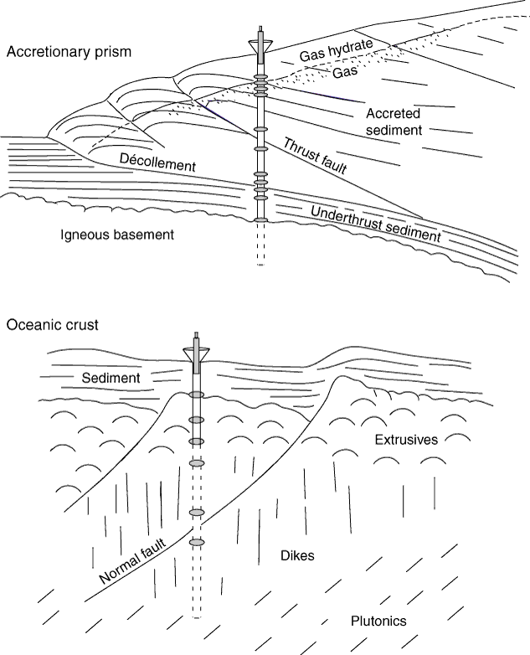
Becker and Davis (2005)

Slide 35
Outline
Scientific Drilling Capabilities
Borehole Seismology
Borehole Hydrology & Geodetic Monitoring
  Motivation
  CORK Observatories
  Examples
    Juan de Fuca Plate
    Nankai
    Costa Rica
Drilling for Geodynamic Monitoring in Cascadia

Slide 36
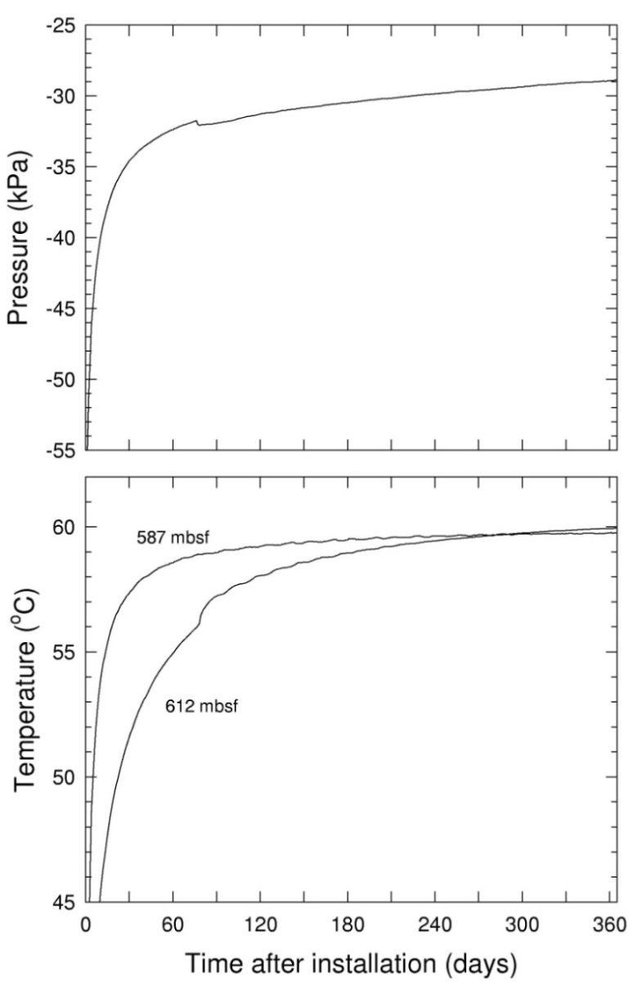
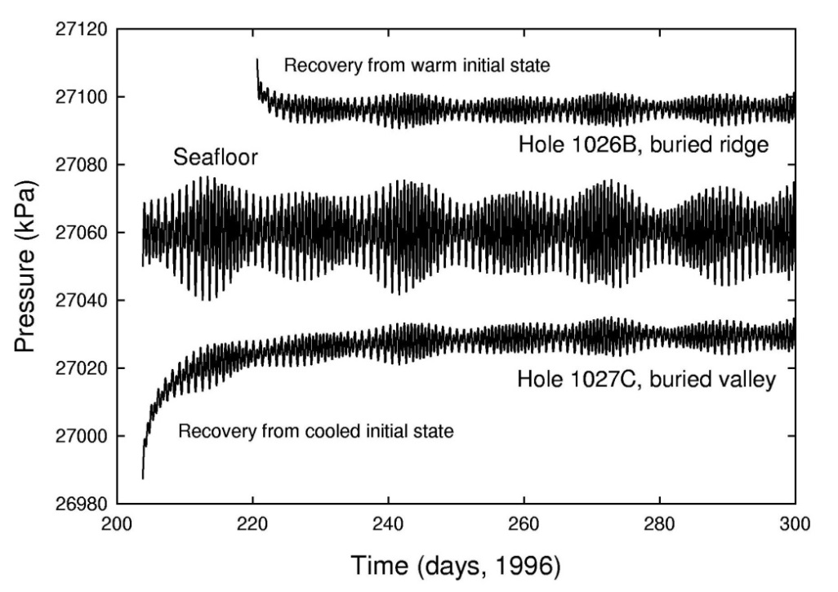
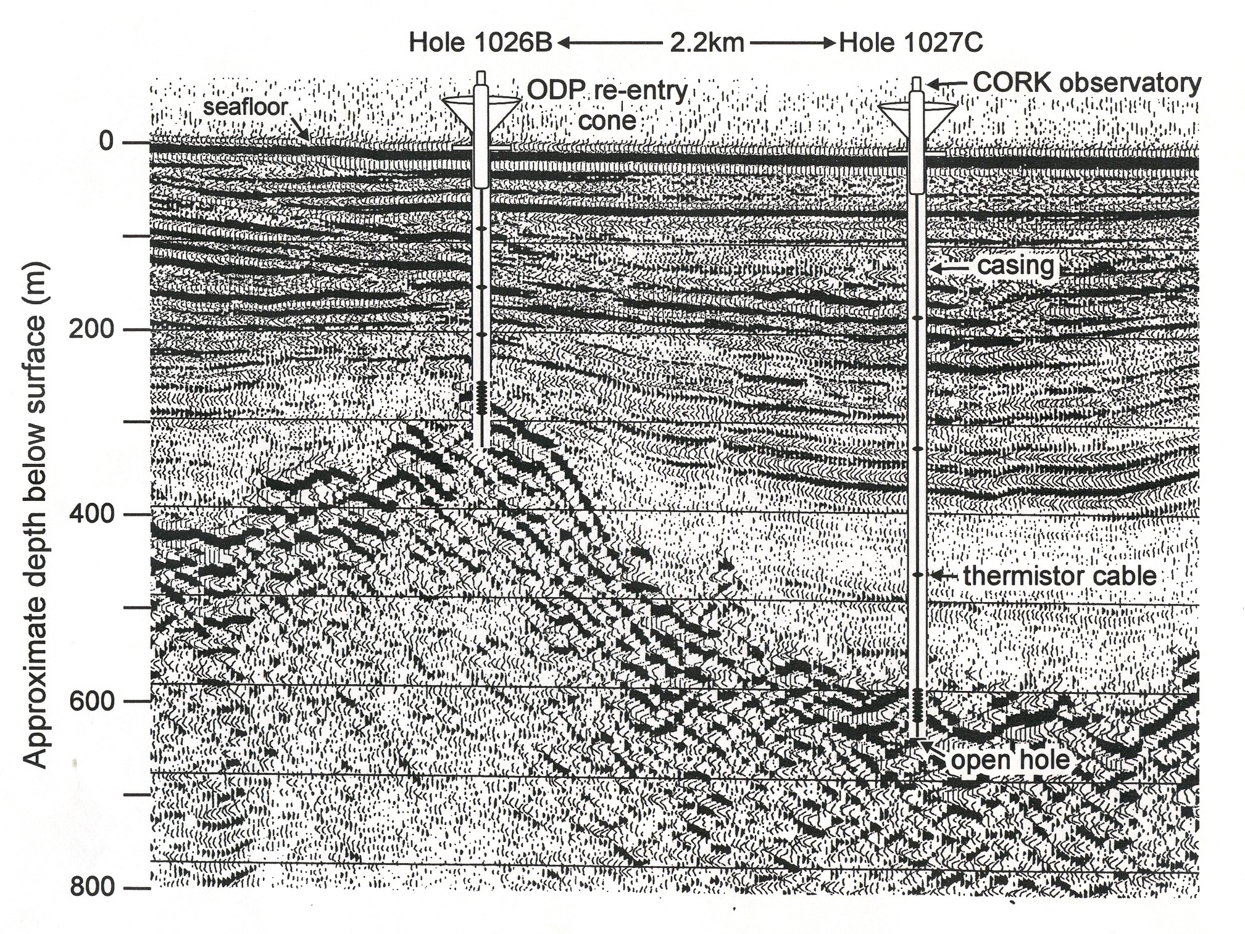
Early experiments: quantifying static driving forces for hydrothermal circulation in oceanic crust
Diminishing
buoyancy anomaly
Tides filtered,
Hole 1027C
Slow recovery
from drilling perturbation
Static and tidal formation pressures
from Earl Davis presentation at 2015 Cascadia Drilling Workshop
Notes:
Sign of dP is clear: P beneath valley is low, beneath ridge high, which suggests high k

Slide 37
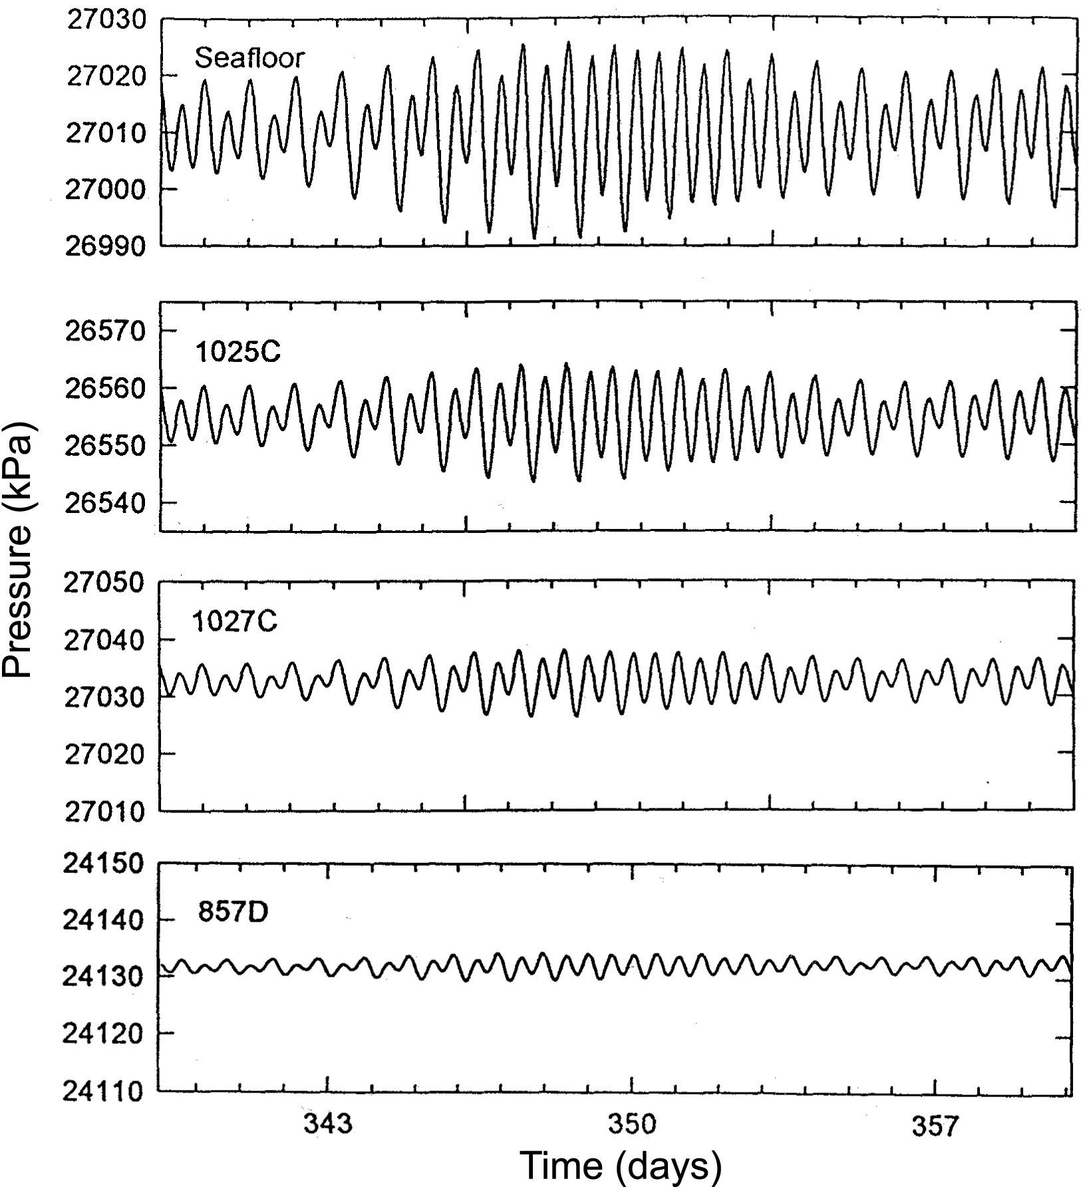
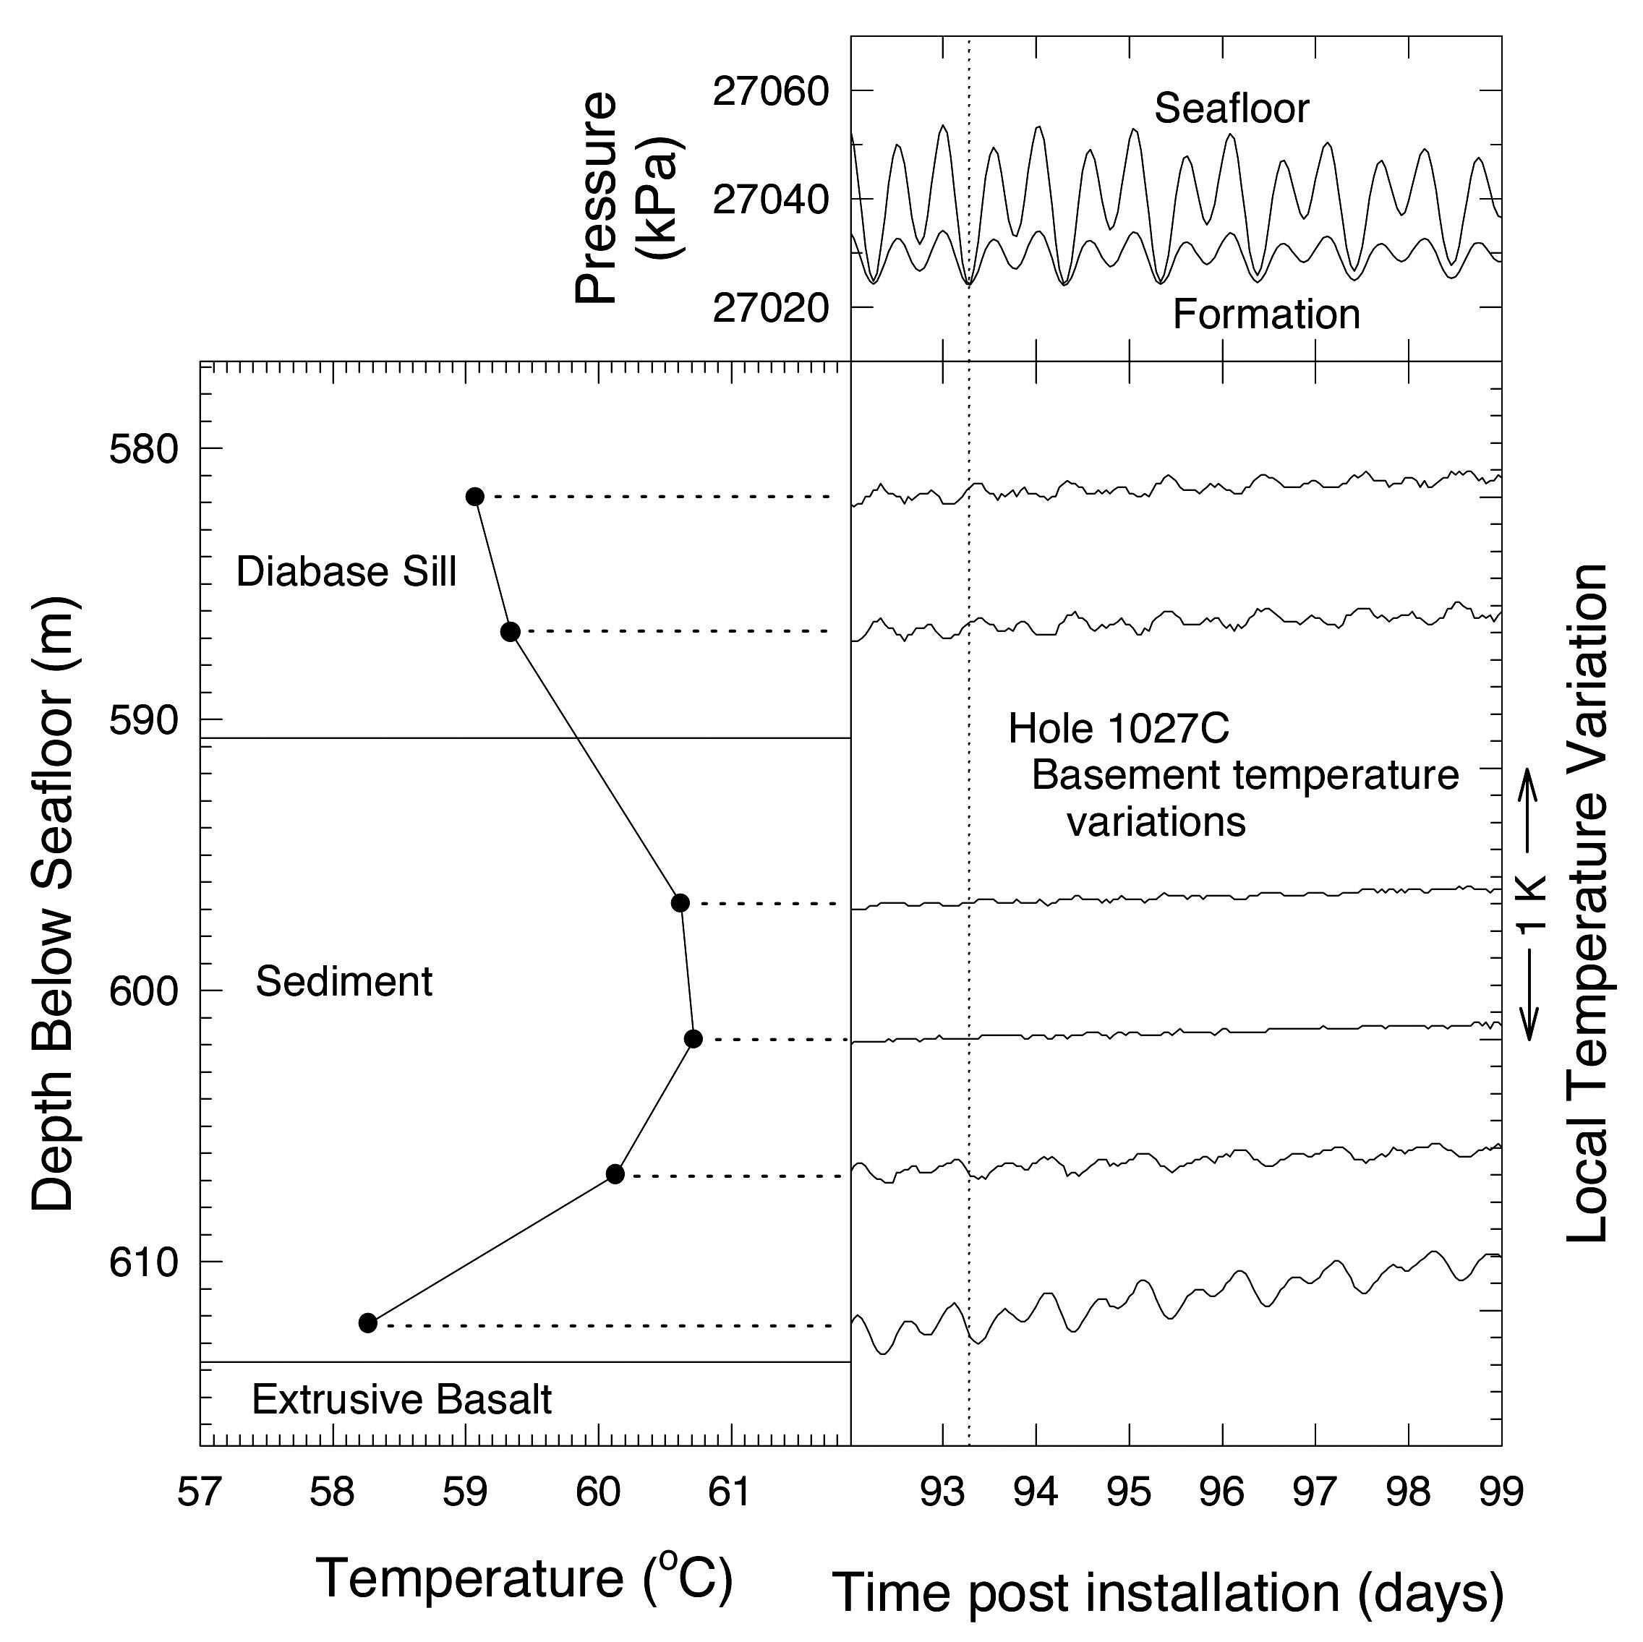
Observed response to seafloor loading
Increasing alteration
Amplitude response
=> elastic properties
Phase, and temperature response
=> diffusion, flow
from Earl Davis presentation at 2015 Cascadia Drilling Workshop
Notes:
37
Computed compressibilities of upper crust range from xx to xx Pa-1

Slide 38
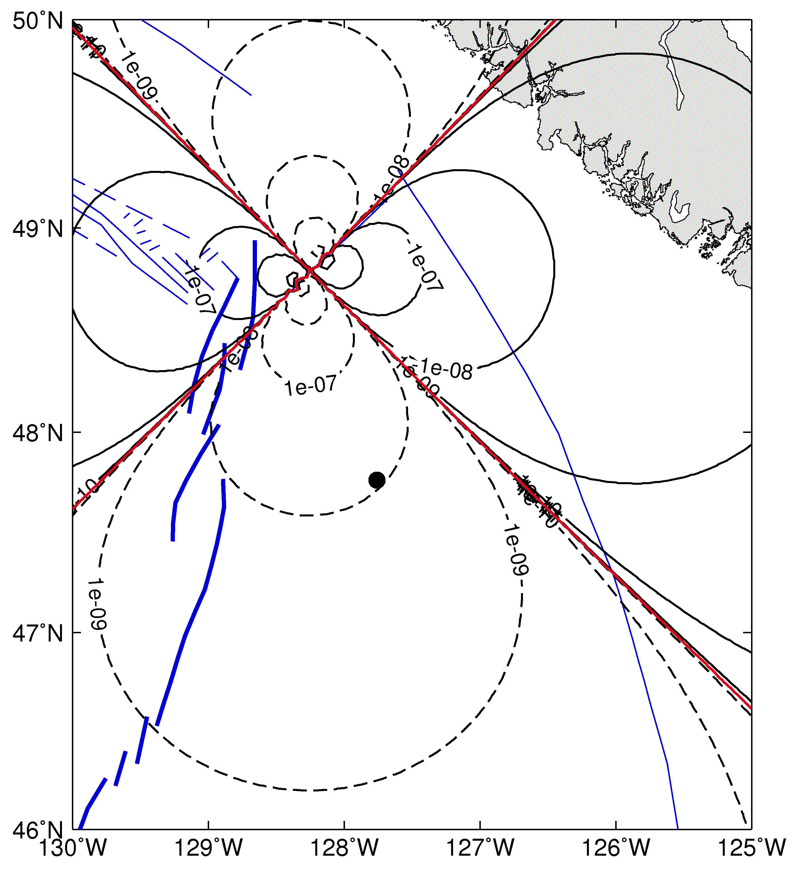
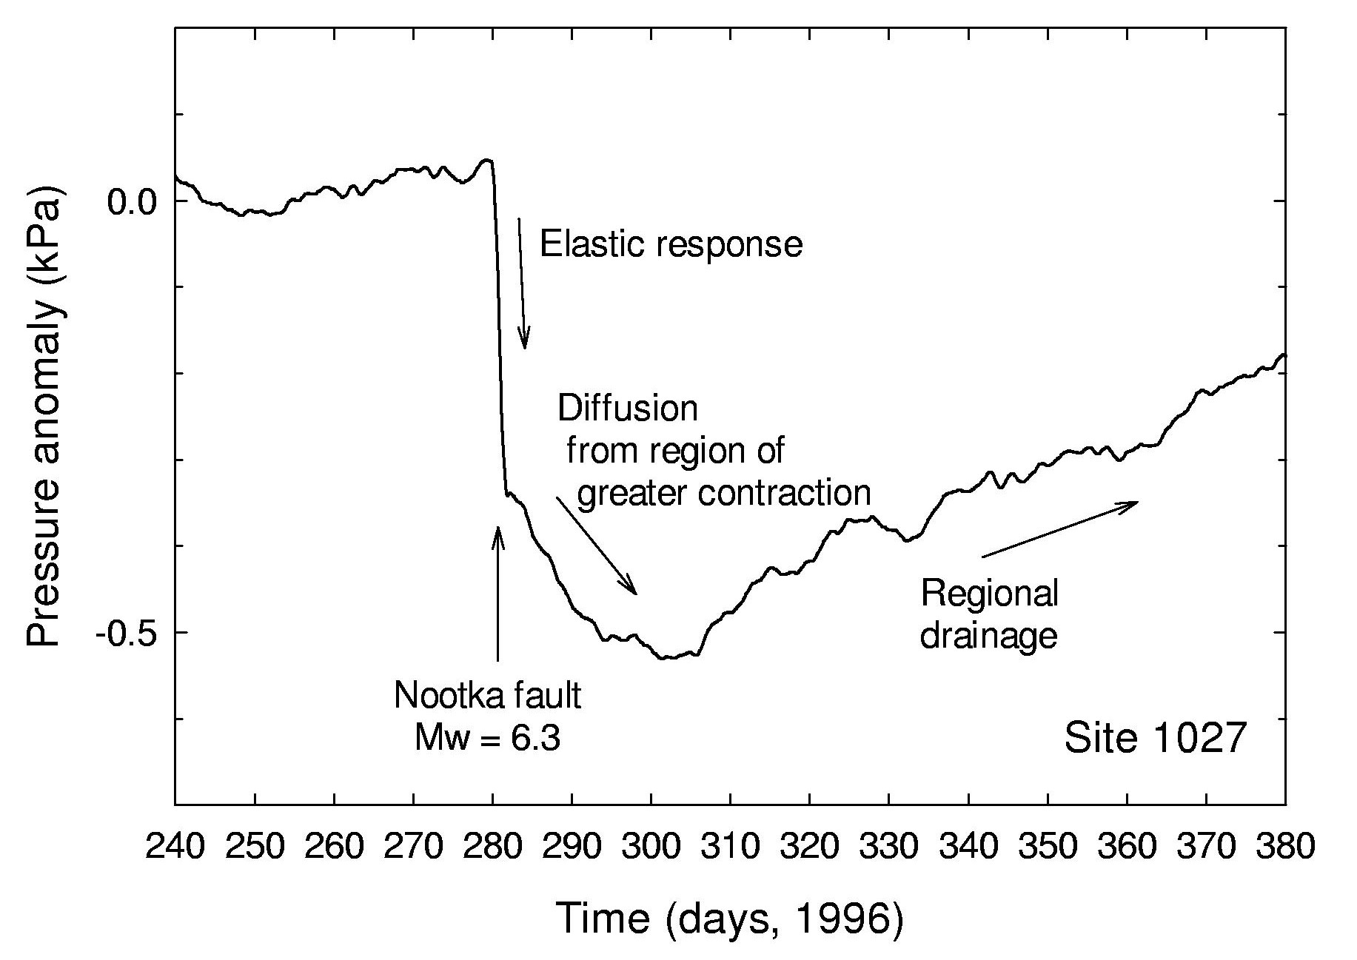
First clear example of strain: response to Mw 6.3 event at 130 km range
Dilatation then lateral drainage and/or post-seismic strain at Hole 1027C
(note: it is hard to distinguish hydrologic diffusion and post-seismic strain)
1027C
from Earl Davis presentation at 2015 Cascadia Drilling Workshop

Slide 39
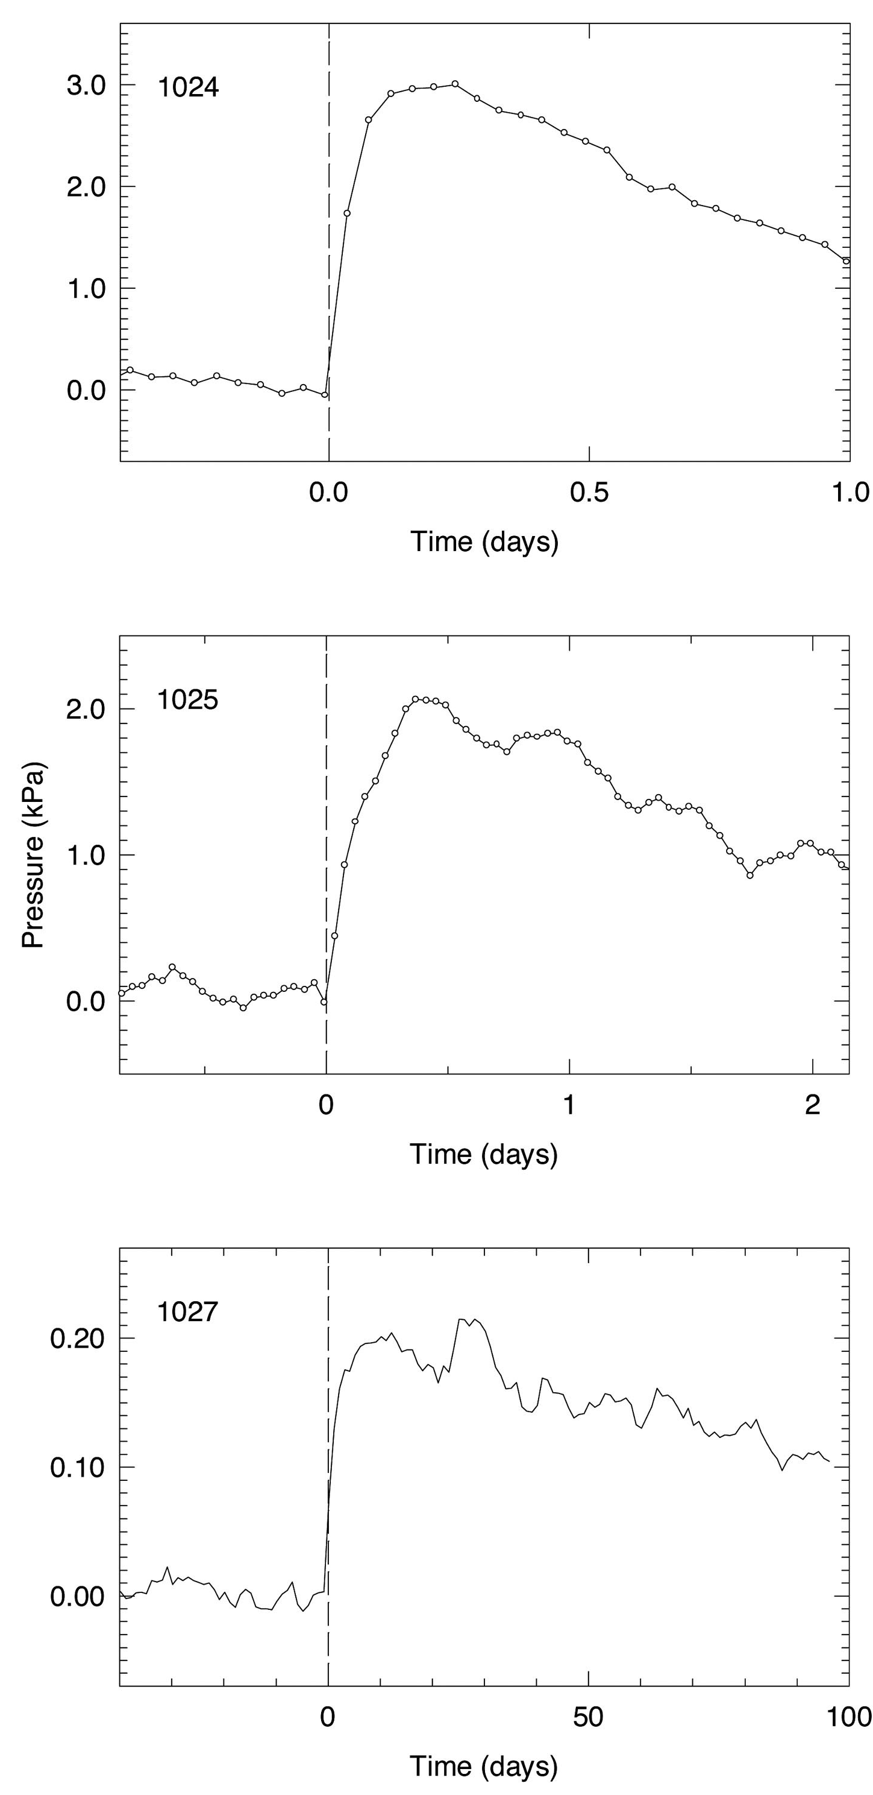
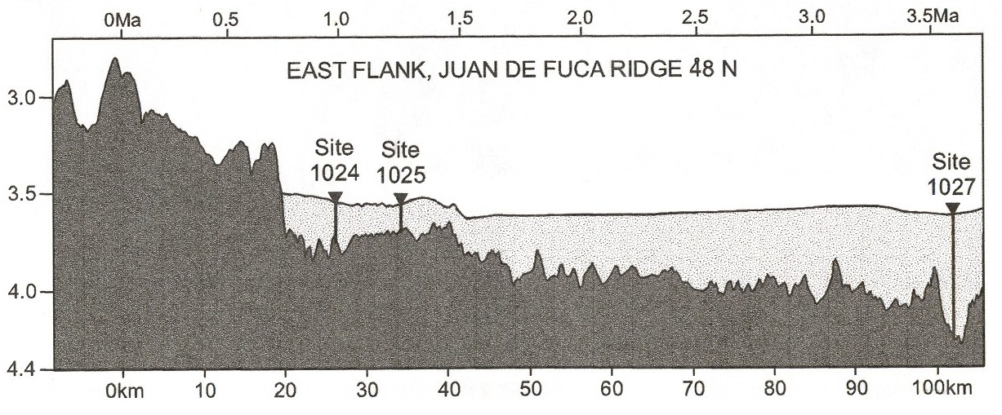
An example seen at multiple sites:
A seismogenic seafloor spreading event with associated plate contraction, then hydrologic drainage and/or viscoelastic relaxation
1999
Endeavour
axis
Decreasing amplitude, decreasing strain …
Decreasing time constant, decreasing drainage path
from Earl Davis presentation at 2015 Cascadia Drilling Workshop

Slide 40
Outline
Scientific Drilling Capabilities
Borehole Seismology
Borehole Hydrology & Geodetic Monitoring
  Motivation
  CORK Observatories
  Examples
    Juan de Fuca Plate
    Nankai
    Costa Rica
Drilling for Geodynamic Monitoring in Cascadia

Slide 41
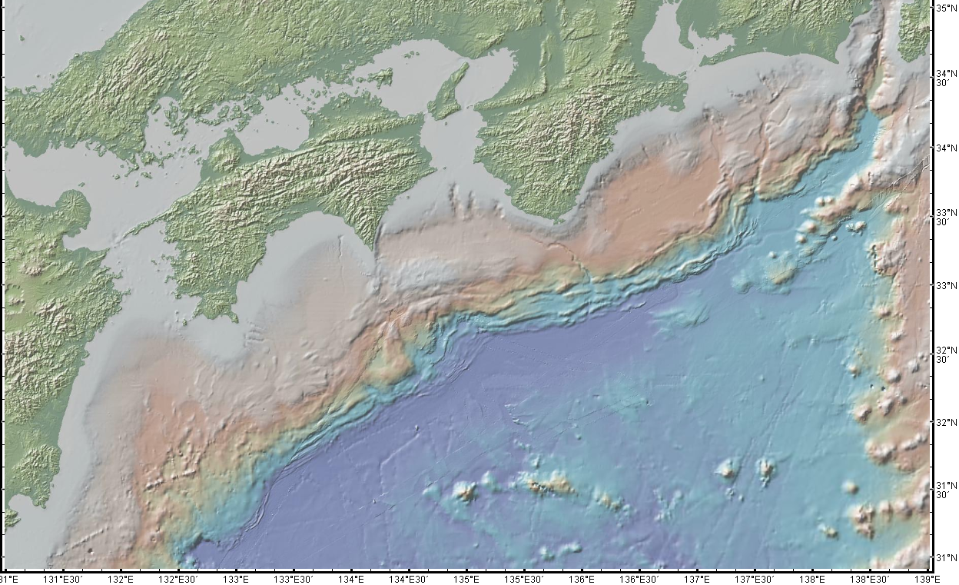
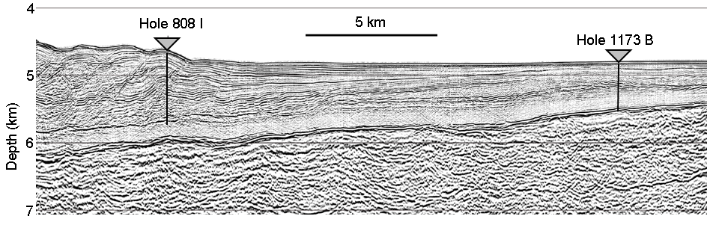
CORK observatories at
Nankai subduction zone
808/1173, 2001
C0002/C0010, 2009
Kii
Peninsula
Cape
Murto
C0002
Bungo
Channel
C0010
C0006
Nankai Trough
808
1173
4.5 cm/yr
from Earl Davis presentation at 2015 Cascadia Drilling Workshop

Slide 42
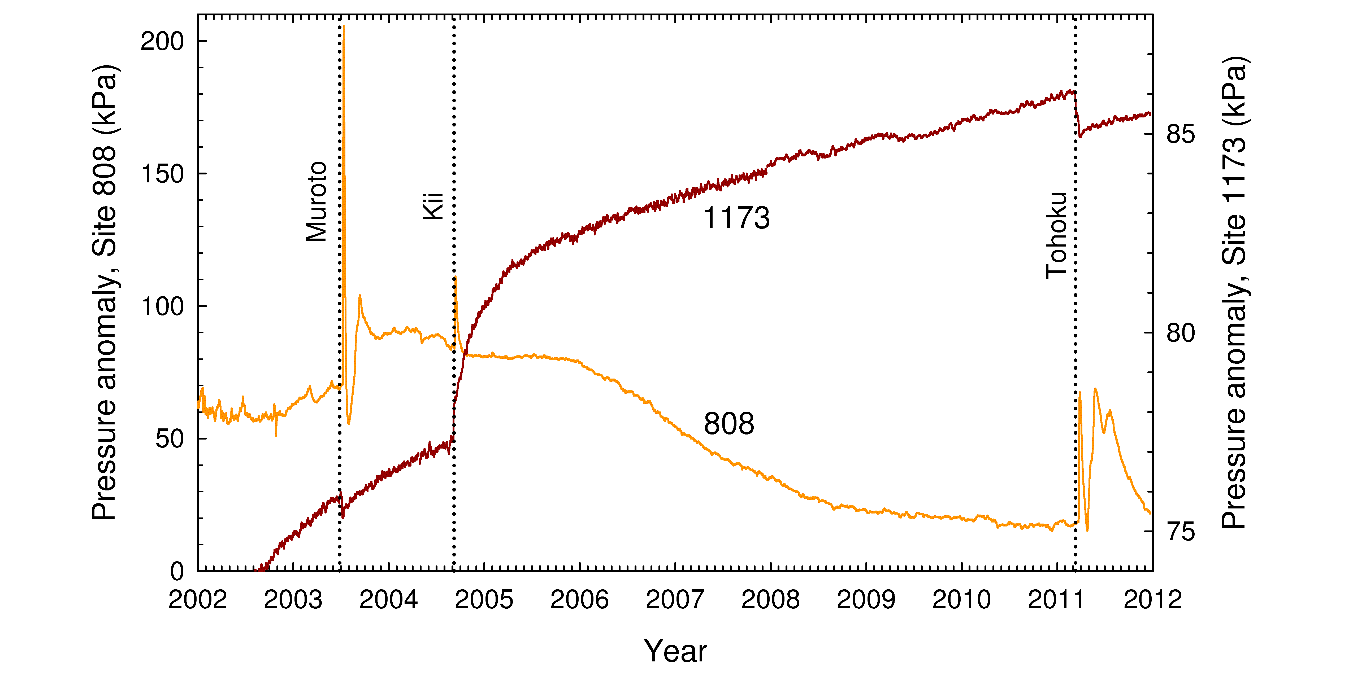
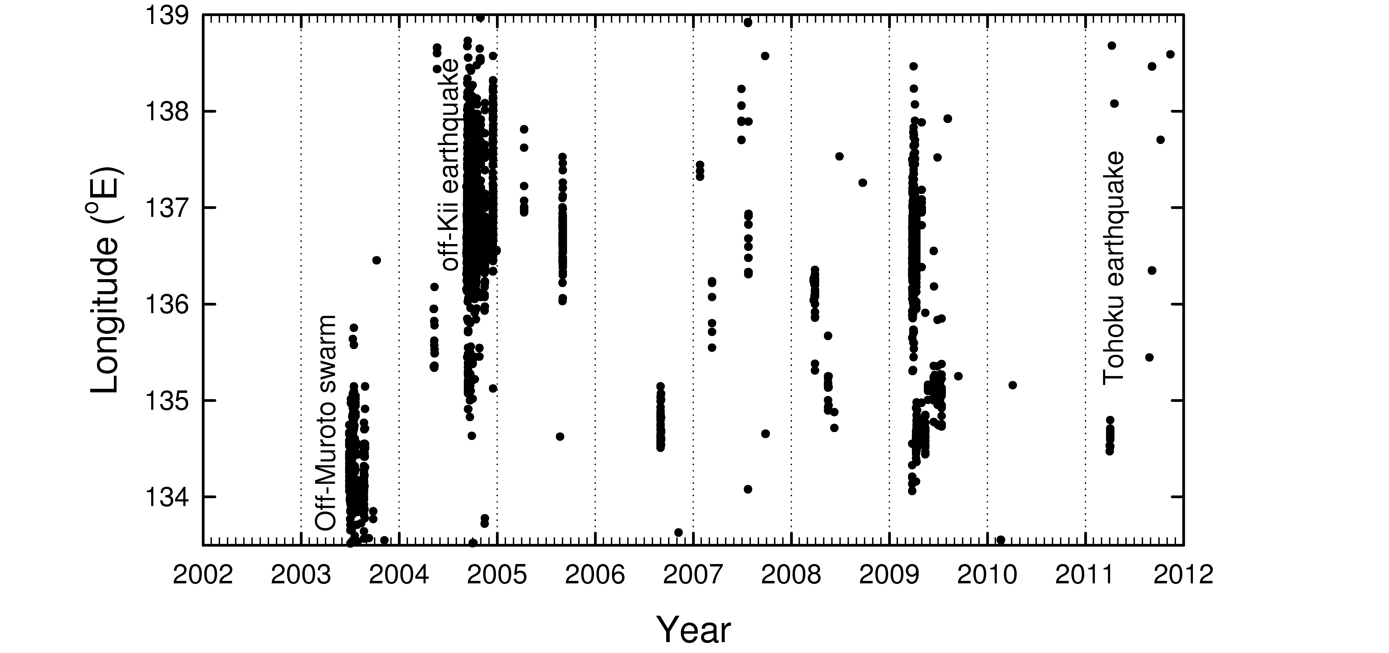
Pressure variations at Nankai Holes 808I and 1173B ACORKs:
accumulating strain, co- and post-seismic strain, triggered local subduction thrust slip
Pressure history
Secular strain accumulation
VLFE activity
C0010/0002
808/1173
from Earl Davis presentation at 2015 Cascadia Drilling Workshop

Slide 43
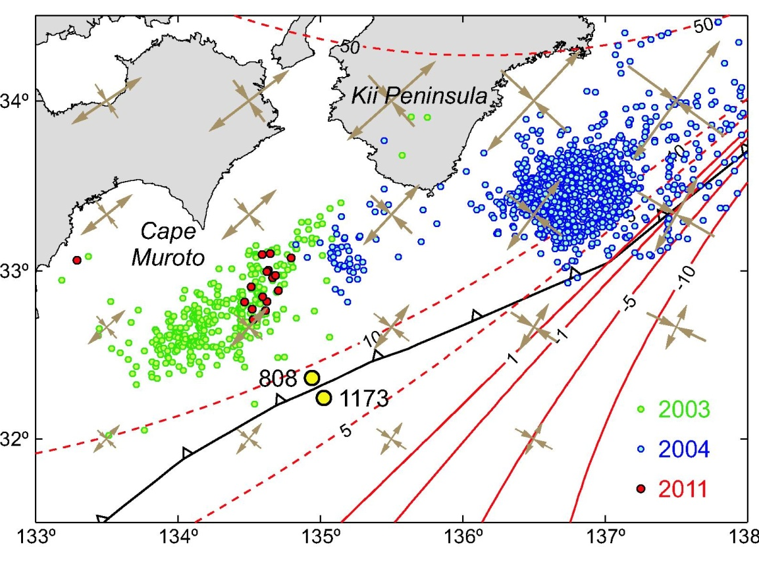
… example of “spontaneous” slow slip: Strain following 2003 VSFEs
Incoming plate
Subduction prism
60 km/9 days
VLFEs
Slip propagates slowly updip from VLFE swarms
from Earl Davis presentation at 2015 Cascadia Drilling Workshop

Slide 44

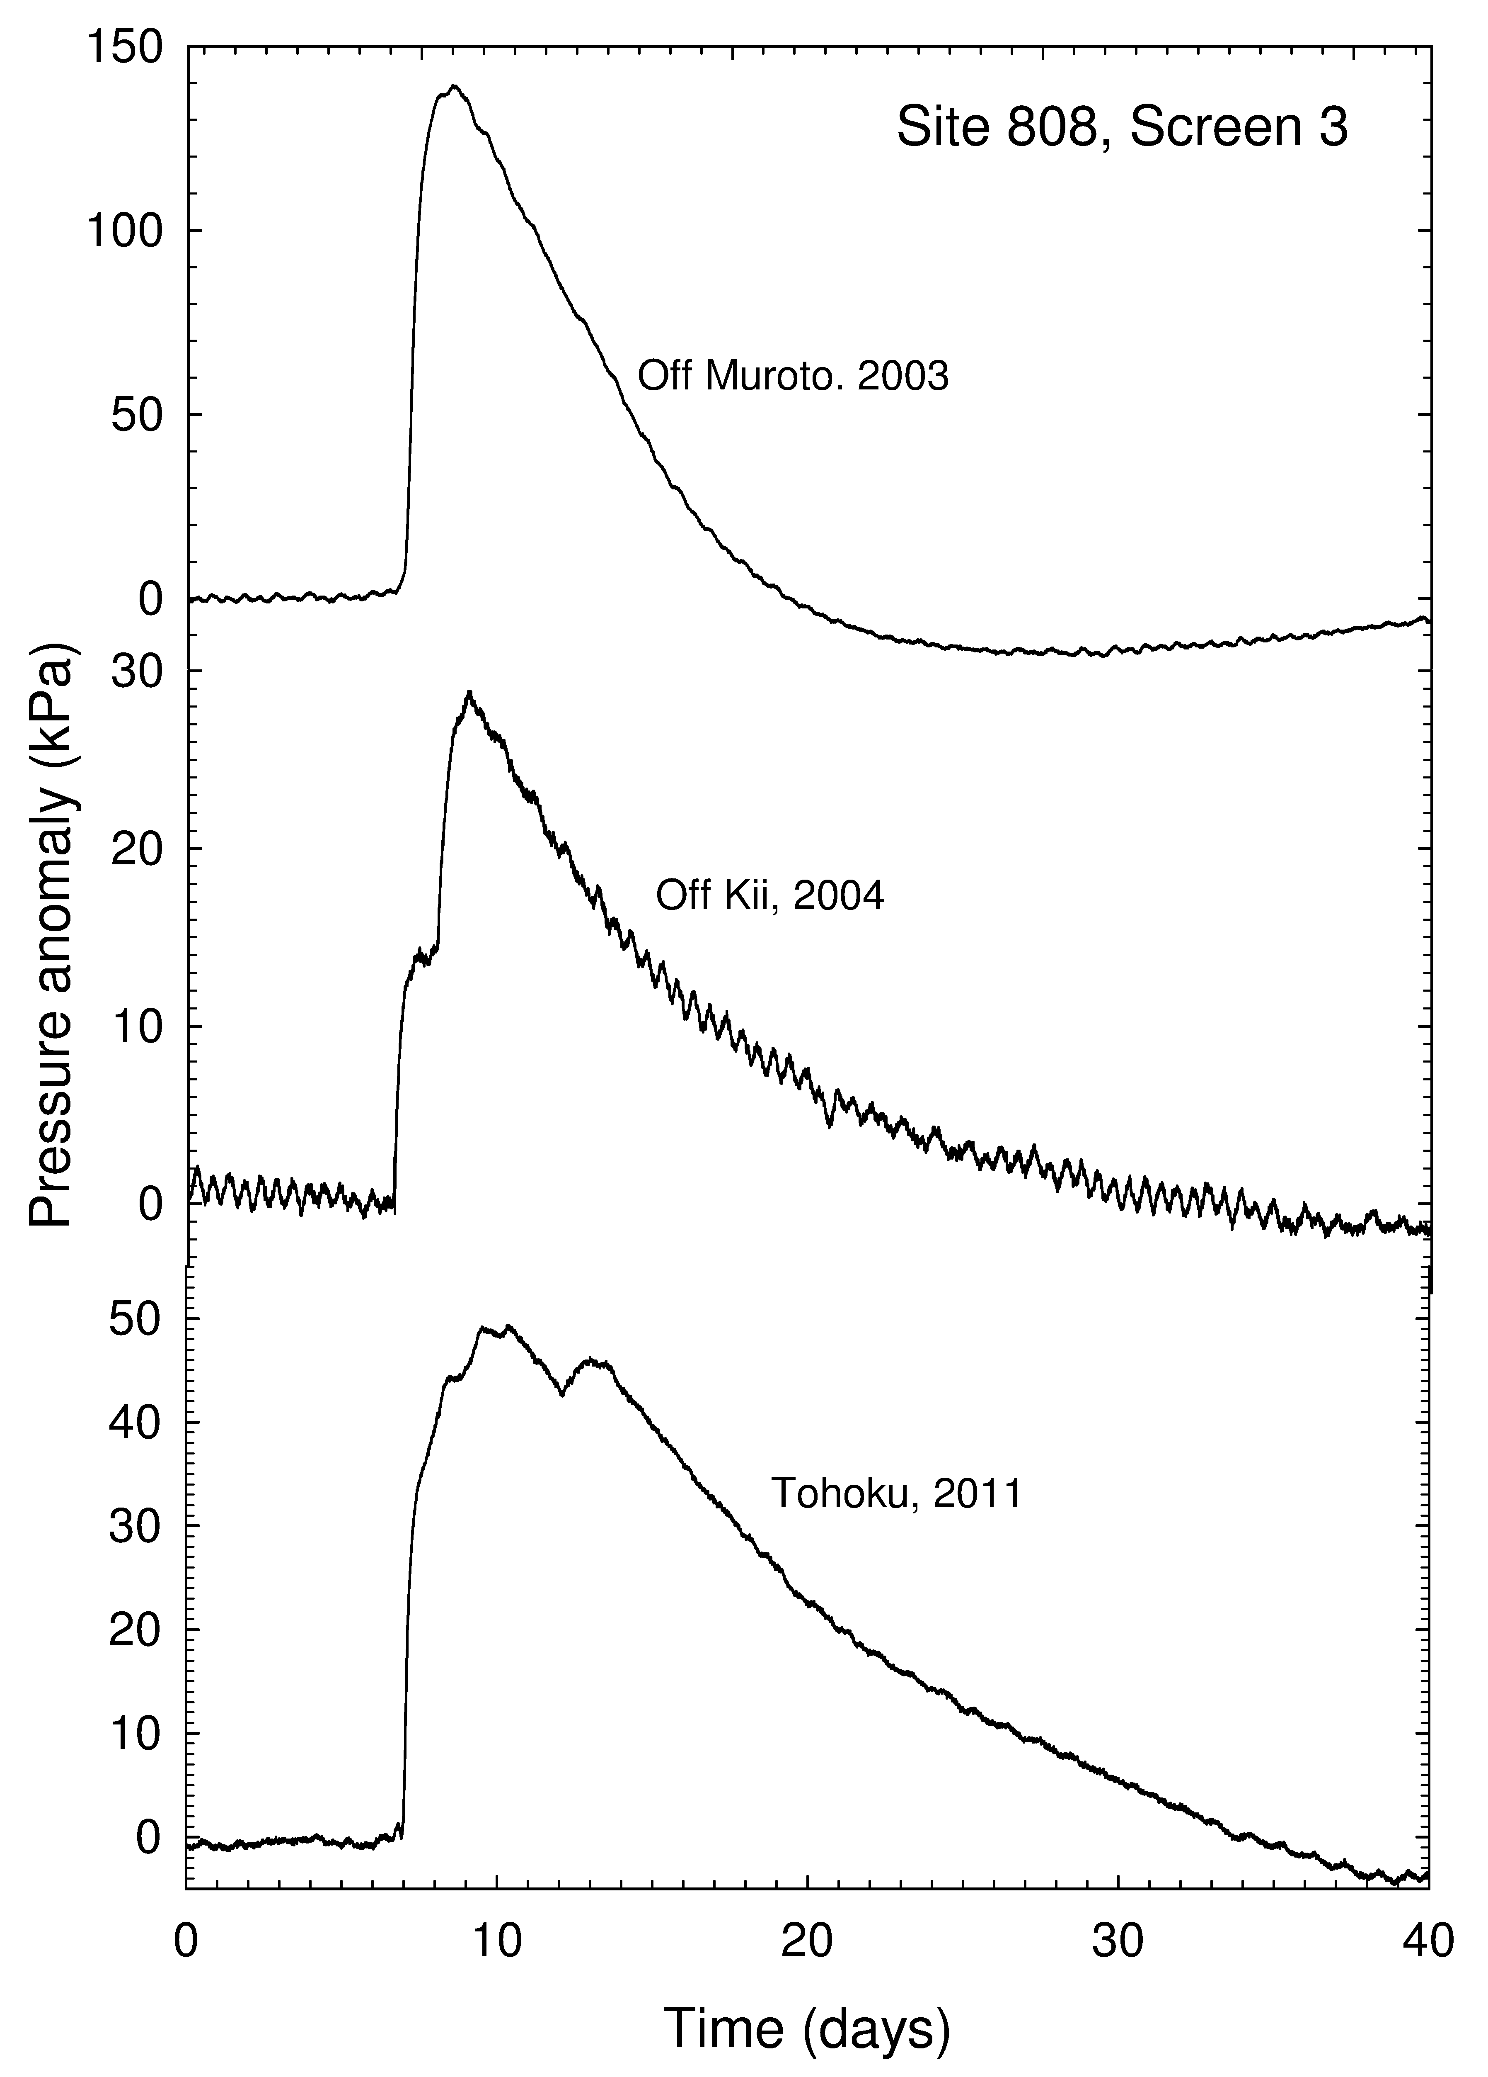
Causes of other transients at Nankai prism toe:
Local decollement slip triggered by small (few kPa) stress changes?
2011 Tohoku
Mw 9.0
2004 off Kii
Mw 7.5
2003 (spontaneous)
2004 (off Kii, 220 km)
2011 (Tohoku, 940 km)
Tohoku volumetric strain, labels in nanostrain
Arial strain, 175 nanostrain max
from Earl Davis presentation at 2015 Cascadia Drilling Workshop

Slide 45
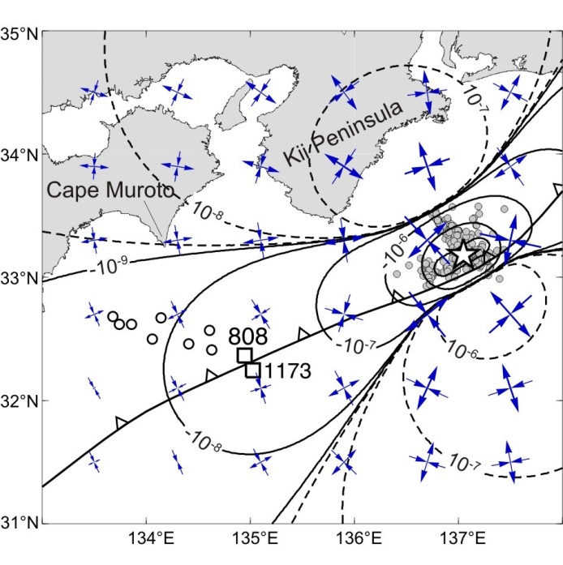
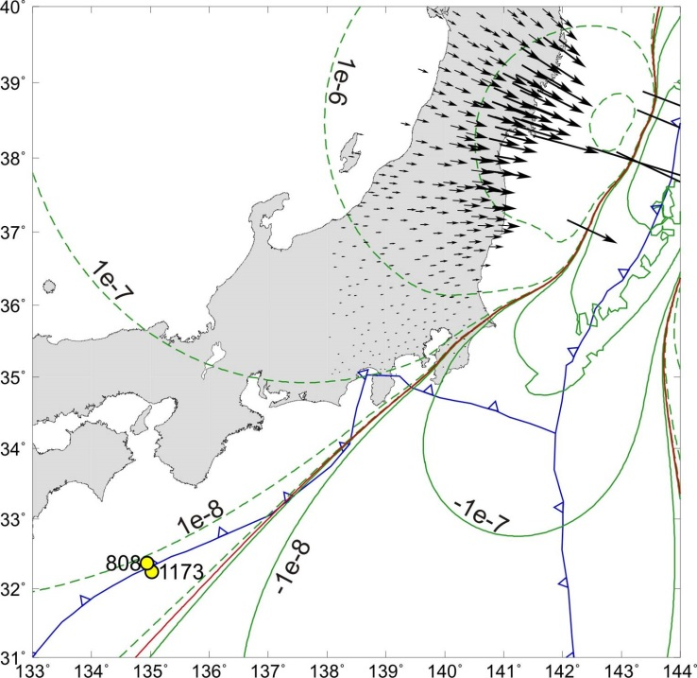
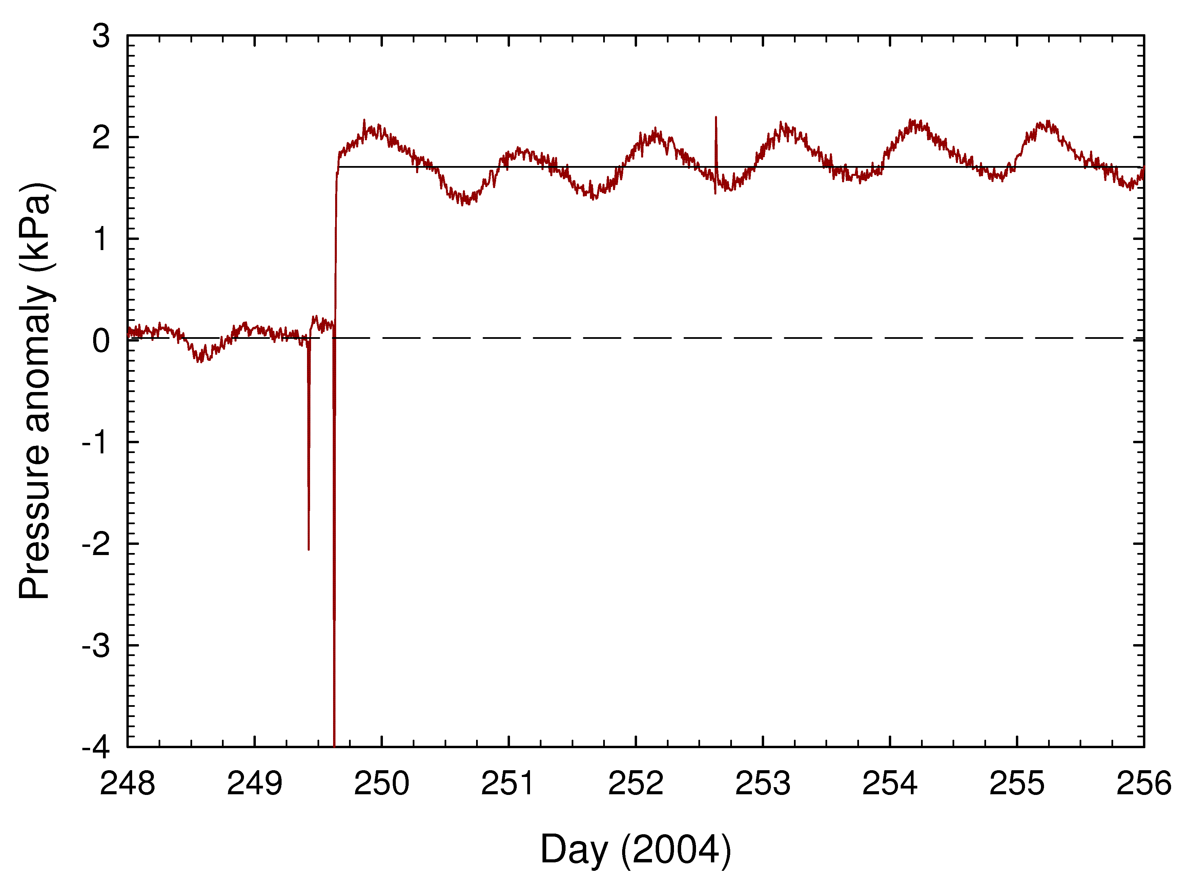
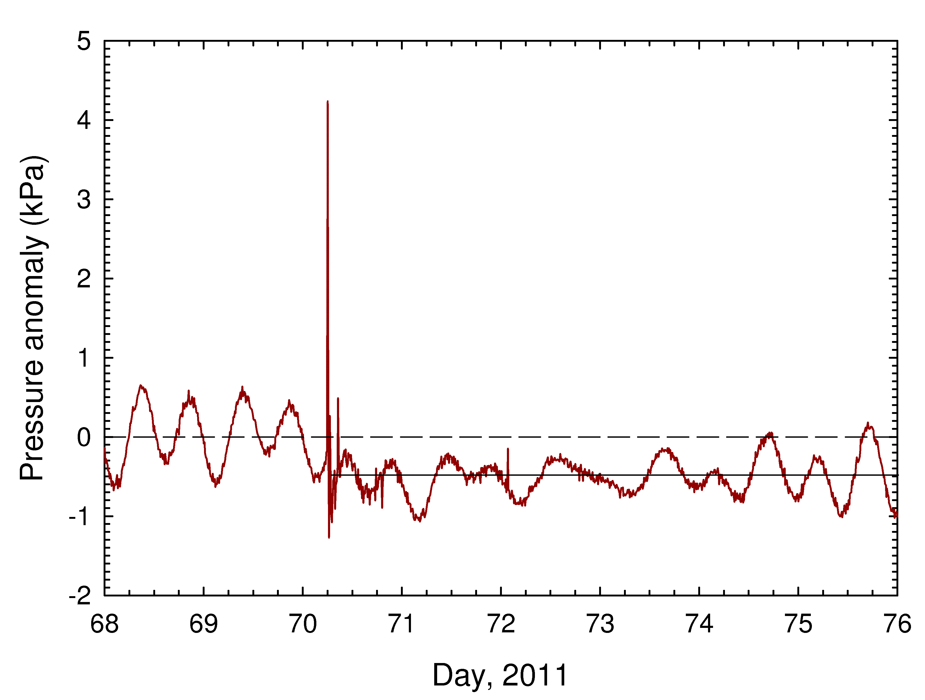
Coseismic response toTohoku and off-Kii earthquakes at Site 1173:
ΔP is consistent in sign with that predicted for Coulomb deformation
+ 1.7 kPa (contraction)
Tohoku
Mw 9.0
940 km
Off-Kii
Mw 7.1, 7.5
220 km
(<0.1 kPa expected)
but amplitude is too large
(0.2 kPa expected)
-0.5 kPa (dilatation)
from Earl Davis presentation at 2015 Cascadia Drilling Workshop

Slide 46
Outline
Scientific Drilling Capabilities
Borehole Seismology
Borehole Hydrology & Geodetic Monitoring
  Motivation
  CORK Observatories
  Examples
    Juan de Fuca Plate
    Nankai
    Costa Rica
Drilling for Geodynamic Monitoring in Cascadia

Slide 47
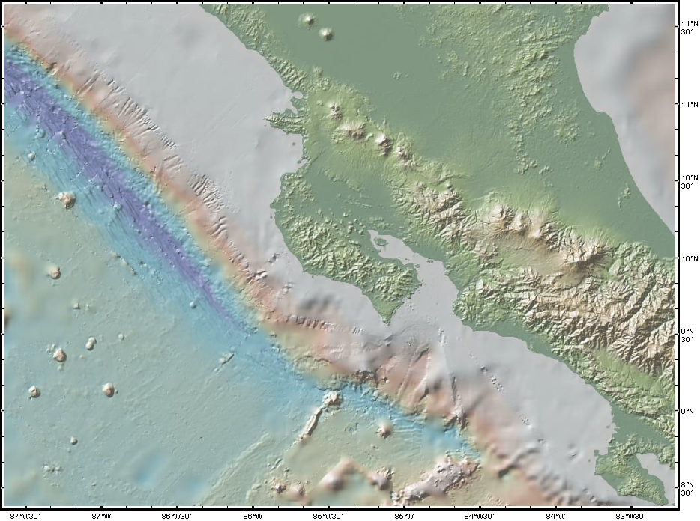
Final examples: Middle America Trench off Costa Rica
100 km
Middle America Trench
ODP
CORK Holes
1253A, 1255A
Nicoya Peninsula
8 cm/yr
1255
1253
from Earl Davis presentation at 2015 Cascadia Drilling Workshop

Slide 48
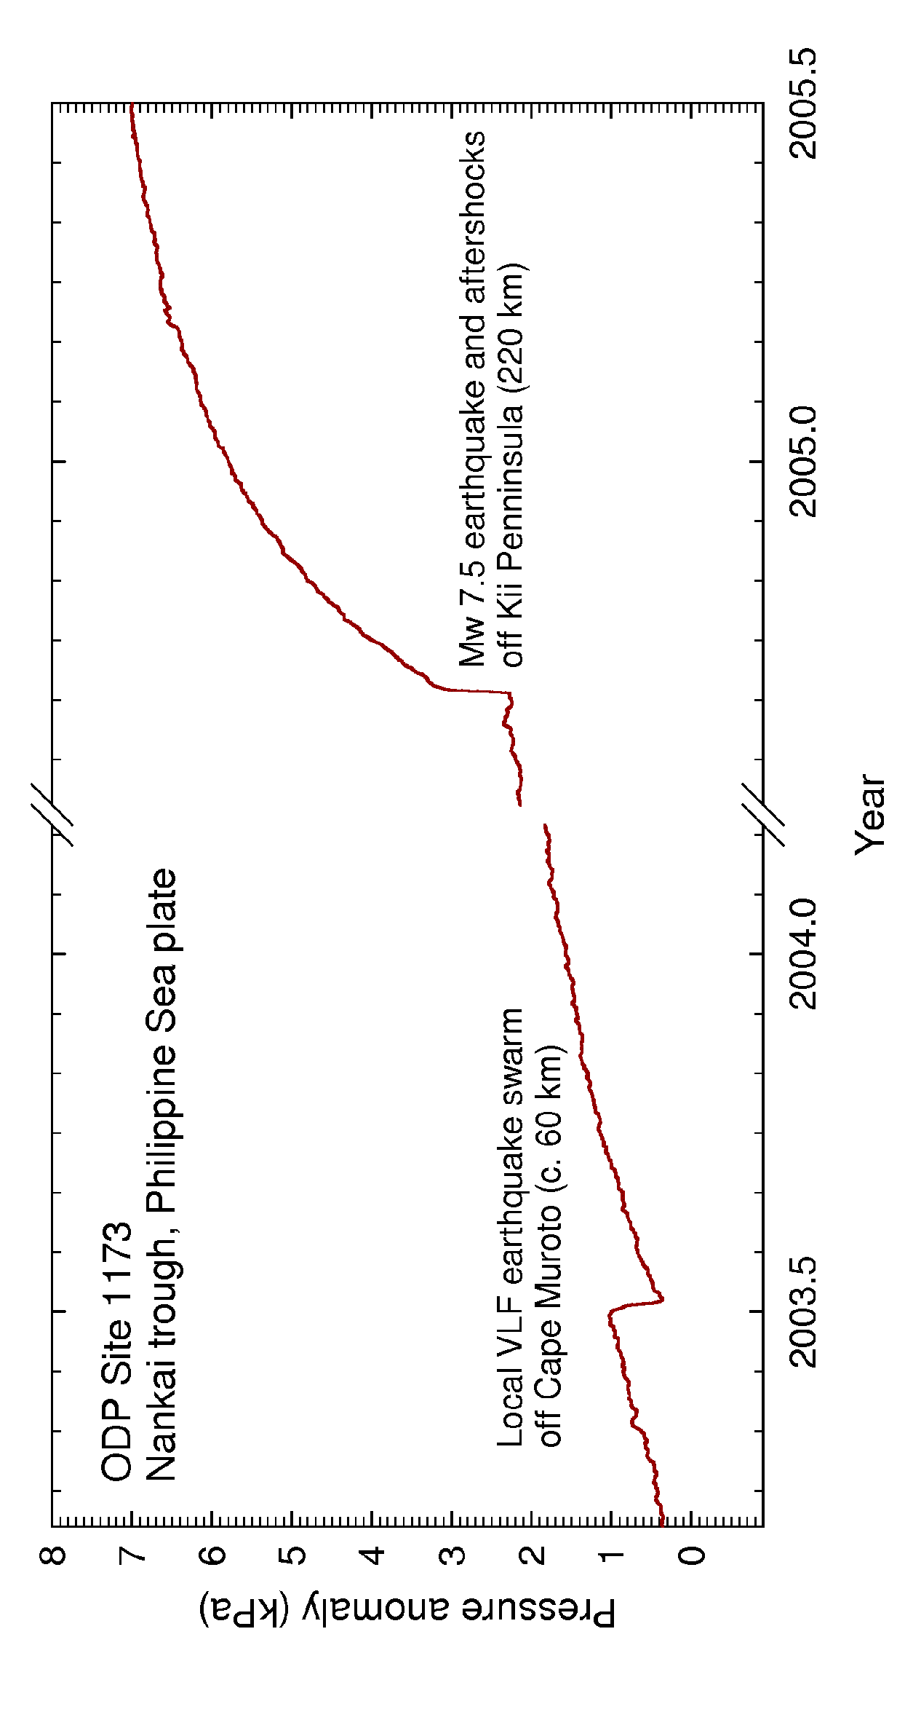

General similarities to Nankai: Secular strain, episodic events,
and static pressure changes
from Earl Davis presentation at 2015 Cascadia Drilling Workshop

Slide 49
Similarities in detail: slow propagation of slip to prism toe
up-dip thrust slip propagation ~ 5-10 km/day
Costa Rica
Nankai
Incoming plate
Subduction prism
100 km / 11 days
60 km / 9 days
VLFEs
Tremor
from Earl Davis presentation at 2015 Cascadia Drilling Workshop

Slide 50







Each event follows slow slip beneath Nicoya Peninsula
and differential seafloor pressure indicates prism uplift
from Earl Davis presentation at 2015 Cascadia Drilling Workshop

Slide 51






Repeated similar signals
followed Nicoya thrust earthquake
Coseismic strain = dilatation both sites
Subsequent events => local outer prism slow slip (prism contraction, subducting plate dilatation)
First local slip event 1.5 days post earthquake
from Earl Davis presentation at 2015 Cascadia Drilling Workshop

Slide 52


Remaining puzzle: In this case, the sign of the coseismic strain is “wrong” (uniform half-space is inadequate) …
observation
dilatation
dislocation model in uniform half-space
contraction
from Earl Davis presentation at 2015 Cascadia Drilling Workshop

Slide 53
Outline
Scientific Drilling Capabilities
Borehole Seismology
Borehole Hydrology & Geodetic Monitoring
  Motivation
  CORK Observatories
  Examples
    Juan de Fuca Plate
    Nankai
    Costa Rica
Drilling for Geodynamic Monitoring in Cascadia
  Status of current geodetic studies
  10+ year plan

Slide 54

Constraining slip distribution of the Cascadia Subduction Zone Offshore Central Oregon with GPS-Acoustic Observations
Accomplishments in 2014:
Two new GPS-Acoustic sites (NGH1, NNP1) deployed on the continental slope in Sept. 2014 from R/V Atlantis.
Re-established existing site (JNP1) on the Juan de Fuca plate using ROV Jason in June 2014 (OTIC funded).
Wave Glider collected GPS-Acoustic data at existing site (JNP1). First deep water (~3000 m) demonstration of Wave Glider-based GPS-Acoustic measurements.
Position times series at JNP1 now extends from 2000 to 2014. Longest tracking of a GPS-A site anywhere.
GPS-A data collection using the Wave Glider scheduled at all three sites for summer 2015
from Dave Chadwell presentation at 2015 Cascadia Drilling Workshop

Slide 55


Pressure Benchmarks with Campaign Calibrations
Collaboration of UW and SIO
Left figure from Dave Chadwell presentation at 2015 Cascadia Drilling Workshop

Slide 56

U1364A Cabled Borehole Observatory
Deployed
orientation
Seabed cable
Hybrid UMC
Receptacle
Panel
Casing
hanger
TCM
SIIM
Skirt over-
hanging
Jumper
to APG
B/U
battery
3.5m
Seafloor
@1329m
2.5m
Q330
Borehole
casing
9.9” ID
Tiltmeters
~2m
2 Pinnacle Denali High Resolution Tiltmeters
2 Jewell A801 low-resolution Tiltmeters
Q330 Data Logger and Baler
Nanometrics Trillium 120 Broadband Seismometer
Seismometer
9.0” OD Ti
housing
Modified from Jeff McGuire presentation at 2015 Cascadia Drilling Workshop

Slide 57
10+-year Drilling Plan
Drill Holes at three locations along the prism
Vancouver Island
Central Washington
Central Oregon
Vancouver Island
Washington
Grays Harbor
Central Oregon
Newport

Slide 58


Slide 59


Slide 60
Challenges
Why go somewhere where there may not be a signal?
  Wait for GPS-Acoustic results
  We will wait that long anyway
Funding
  IODP is short of funding
  Hazards support would help queue jump

