Slide 1
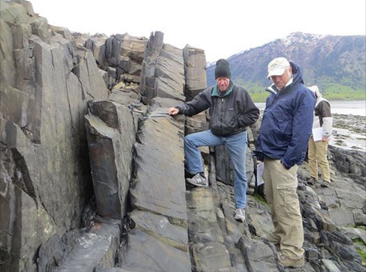
ROCK RECORD OF SUBDUCTION
WHAT IS AN ACCRETIONARY WEDGE?
HOW TO MAKE A WEDGE?
CASCADIA-OLYMPICS EXAMPLE

Slide 2
RESEARCH SITES
FIELD TRIPS
USGS

Slide 3
ROCK RECORD OF SUBDUCTION
WHAT IS AN ACCRETIONARY WEDGE?
HOW TO MAKE A WEDGE?
CASCADIA-OLYMPICS EXAMPLE

Slide 4
?
NANKAI
iodp

Slide 5
ROCK RECORD OF SUBDUCTION
WHAT IS AN ACCRETIONARY WEDGE?
HOW TO MAKE A WEDGE?
CASCADIA-OLYMPICS EXAMPLE

Slide 6
?
NANKAI
TAMU

Slide 7
NANKAI
Rice University

Slide 8
?
?
Github.com

Slide 9
MONTANA FOLD-THRUST BELT
West
East
Crystalline basement of continental North America

Slide 10
ROCK RECORD OF SUBDUCTION
WHAT IS AN ACCRETIONARY WEDGE?
HOW TO MAKE A WEDGE?
CASCADIA-OLYMPICS EXAMPLE

Slide 11
Brandon et al., 1998

Slide 12
APATITE
THERMOCHRONOLOGY

Slide 13
Brandon et al., 1998

Slide 17
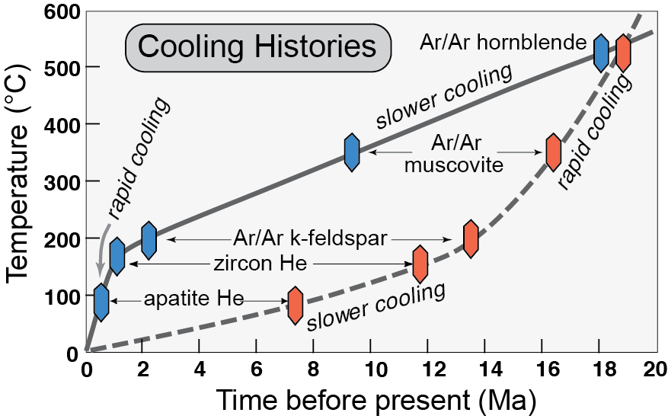
Thermochronology
Burbank and Anderson, 2011, Tectonic Geomorphology, Chapter 7

Slide 18
Brandon et al., 1998

Slide 19
Brandon et al., 1998

Slide 21
RESEARCH SITES
FIELD TRIPS
USGS

