Slide 1
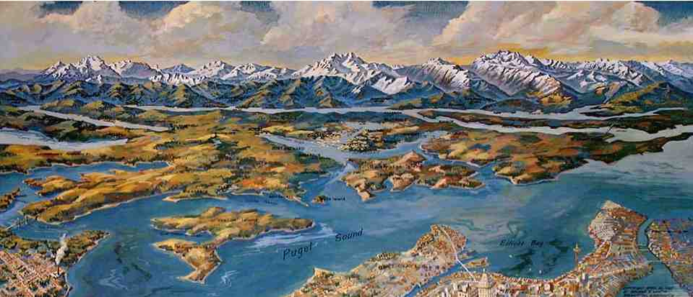
Geomorphology/Landscape Evolution in Subduction Zone Settings
Alison Duvall (ESS)
May 2015 seminar

Slide 2
Geomorphology/Landscape Evolution in Subduction Zone Settings
Topography
River Incision
Hillslopes (seismically – induced landslides)

Slide 3
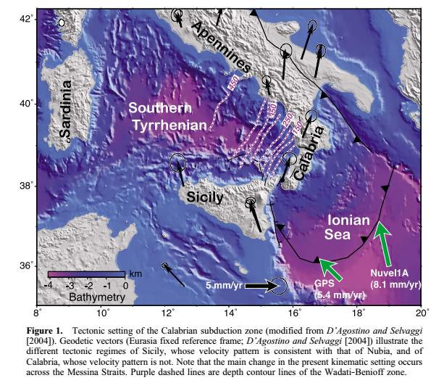
Topography above Subduction Zones
The wavelength & amplitude of topographic features give clues to what is happening at depth & help discriminate among geodynamic hypotheses.

Slide 4
The topography of the upper plate is complex b/c it is a product of a variety of processes operating at different spatial and temporal scales. Including:
Deep crustal underplating, flexural & tectonic processes, and erosion.

Slide 5
Processes that might lead to positive topographic anomaly:
Plate coupling/High-convergence velocity
Detachment of slabs (rapid)
Inflow of asthenospheric material (if fully uncoupled)
Slab window (rapid)
Processes that might lead to topographic sinking:
Trench roll-back/low coupling
Mantle convection excited by subduction

Slide 6
Documenting/deciphering case histories is fundamental to advance our understanding of the causal relationships between topographic changes and mantle flow in subduction zones.
The Calabria/Sicily example represents a young and active subduction zone = good study site.

Slide 7
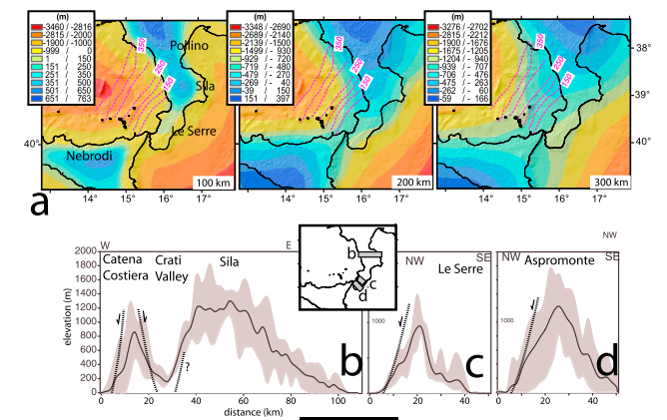

Slide 8
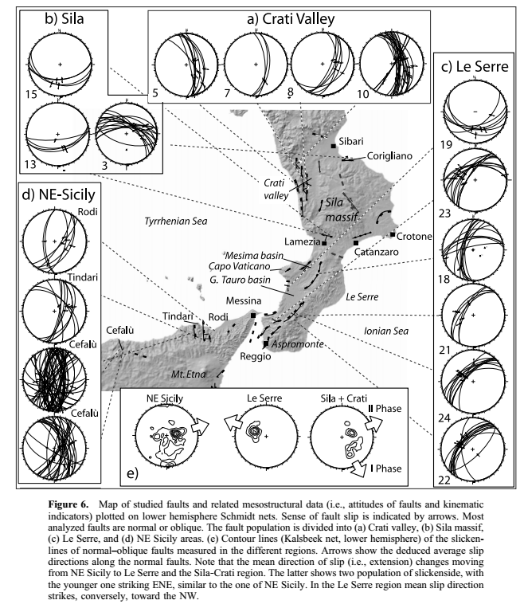

Slide 9
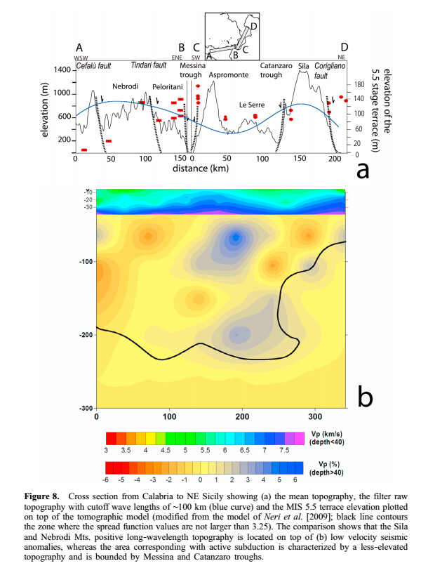

Slide 10
Combined approach + comparison to tomography
yields bottom line:
Deformation (uplift + faulting) at the top of the Calabrian
slab edges is sustained dynamically by Toroidal flow in the
mantle, excited at the edges by the retreat and steepening
of the narrow Calabrian slab.
This, in turn, sets up decompression melting which feeds
the active Mt. Etna volcano.

Slide 11
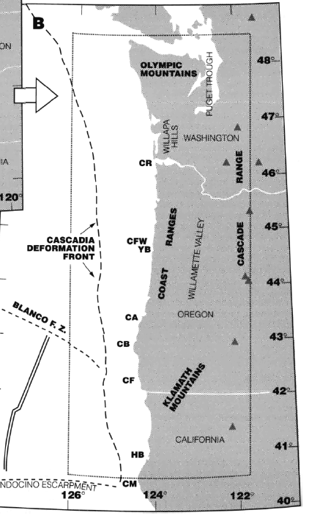

Slide 12
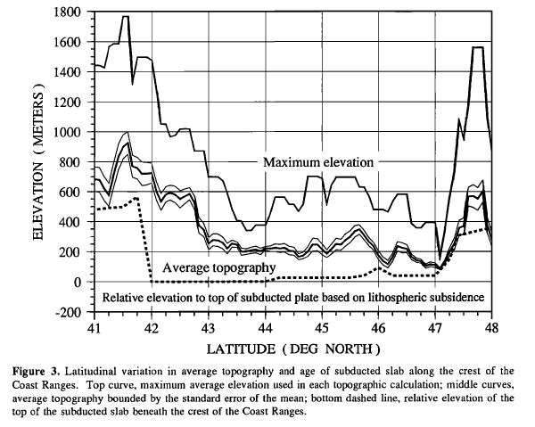
Two highest topographic elements (Olympics and Klamaths)
are underlying by youngest slabs.

Slide 13
River incision above Subduction Zones

Slide 14
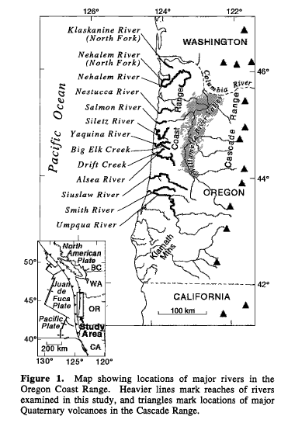

Slide 15
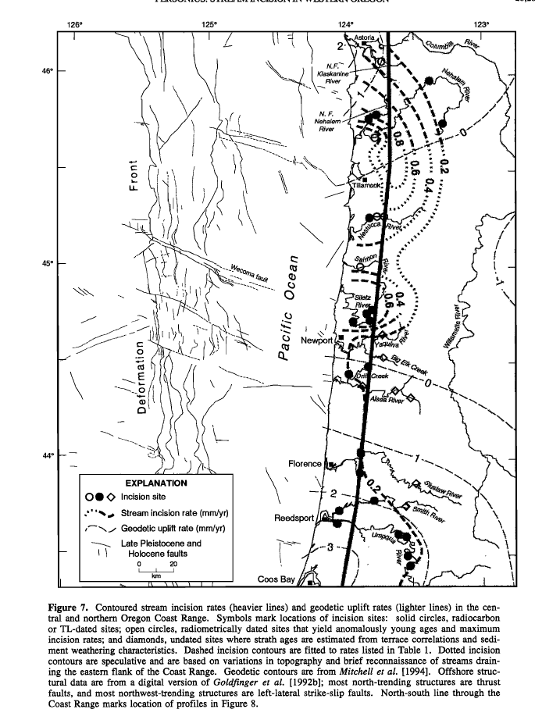

Slide 16
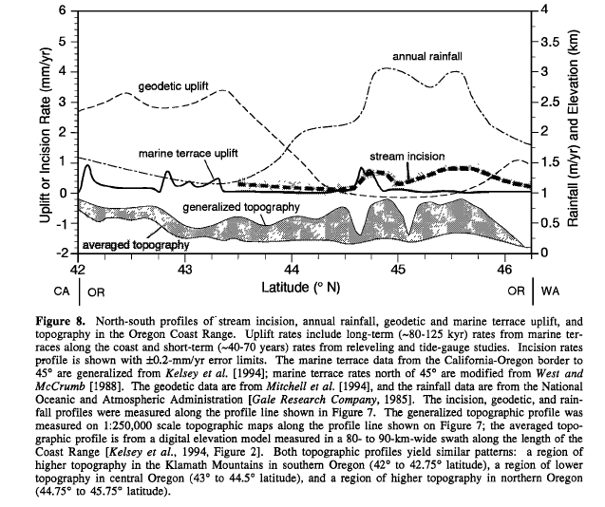

Slide 17
Bottom line conclusions:
Pattern in incision associated with patterns of differential
permanent strain accumulation along Cascadia subduction
Zone.
Potential causes: differences in seismic moment release
during individual earthquakes; changes in plate geometry or
rates of wedge accretion; segmentation of earthquake
ruptures; deformation on active structures in the NA Plate
and wedge

Slide 18
Bottom line conclusions:
Patterns of incision differ along strike. Near latitude of
Newport, OR. A steep gradient divides a region of higher
rates (0.6 – 0.9 mm/yr) in the northern Coast Range from a
region of lower rates (0.1 – 0.3 mm/yr) in central Coast
Range.
This gradient is coincident with abrupt changes in marine
terrace uplift rates and location of Q faults.

Slide 19
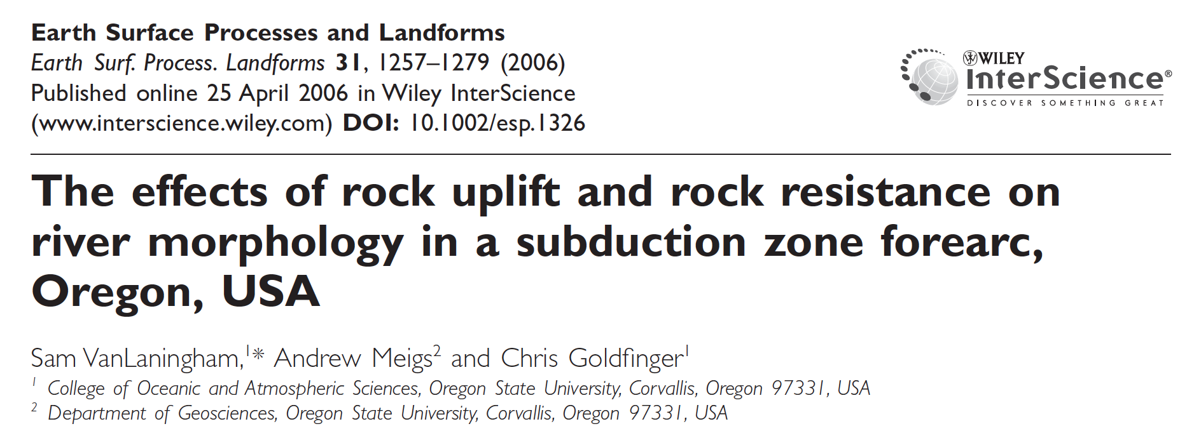
Slope-Area Analysis
River Form Analysis
Lithology is important too!

Slide 20
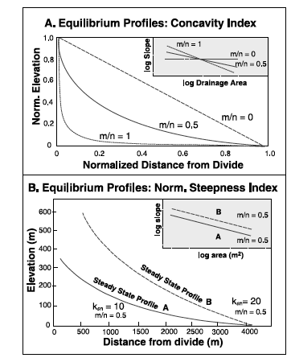
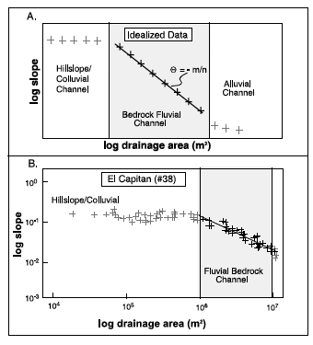
Stream-profile (Slope-Area) Analysis
Duvall et al., 2004

Slide 21
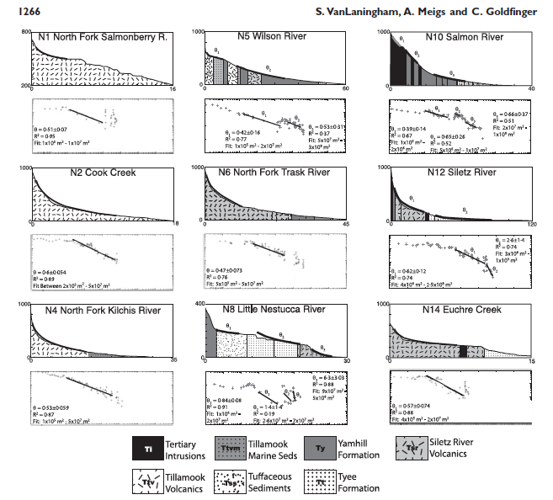

Slide 22
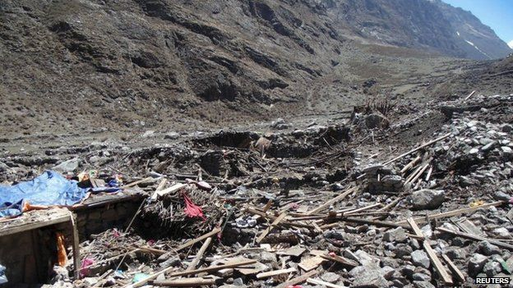
Hillslopes above Subduction Zones

Slide 23
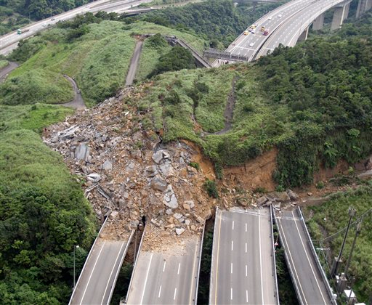
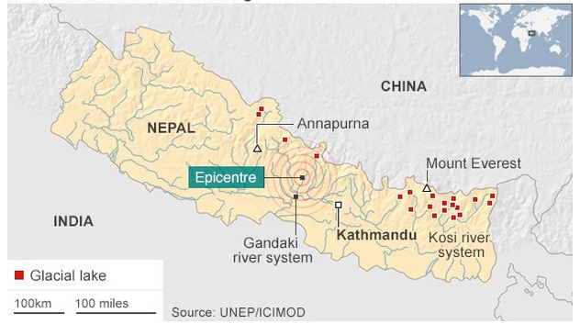
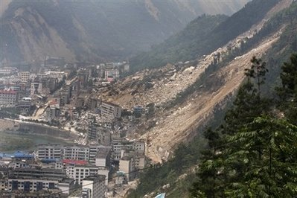
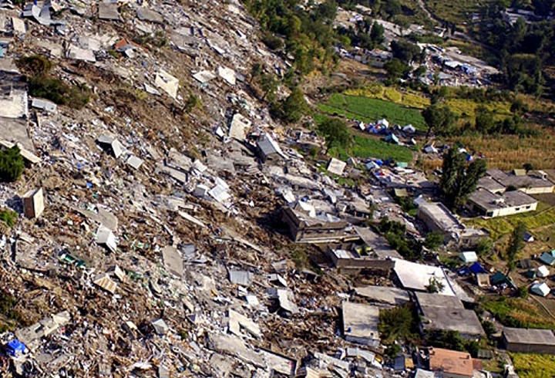
Taiwan, 2010
Nepal, 2011
2015 Nepal earthquakes!
Sichuan, China 2008
Pakistan, 2005

Slide 24
Seismically-induced landslides: some sobering hazard statistics
Historical accounts from as long ago as 1783 reveal the importance of seismic shaking as a landslide trigger and the potential for devastating destruction resulting from this process.
Ex 1: M7.9 earthquake in Rio Santa region of Peru on May 31, 1970: landslides killed more than 18,000 people (Plafker et al., 1971)
Ex 2: 1920 M7.8 Haiyuan earthquake in China – landslides in loess buried as many as 100,000 people (Zhang and Wang, 2007)
Ex 3: 25,500 out of the 87,350 total deaths from the M7.6 Kashmir earthquake (2005) occurred as a result of coseismic landslide

Slide 25
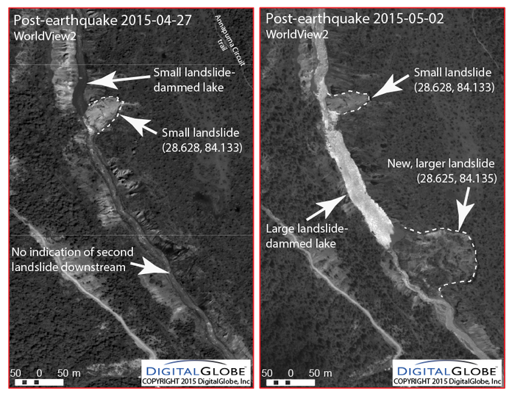
Seismically-induced landslides: some sobering hazard statistics
May 12, 2008 M7.9 Wenquan earthquake in China earthquake triggered ground failure included (Ouimet, 2009):
Burial of infrastructure preventing quick access to affected areas;
River flooding associated with emplacement and breach of landslide dams;
Erosion and flooding associated with the redistribution of unconsolidated landslide material as rivers reestablish course;
Overall increase in river sediment flux in general;
Destabilization of hillslopes that increases the risk of future failure.
Dr. Dan Shugar
UW Tacoma (fall 2015)

Slide 26
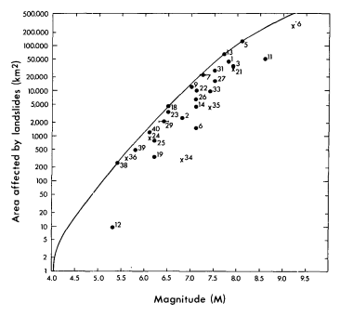
2/8/2010
La Canada-Flintridge, CA

Slide 27
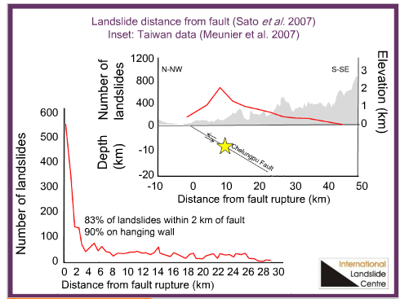
2/8/2010
La Canada-Flintridge, CA

Slide 28
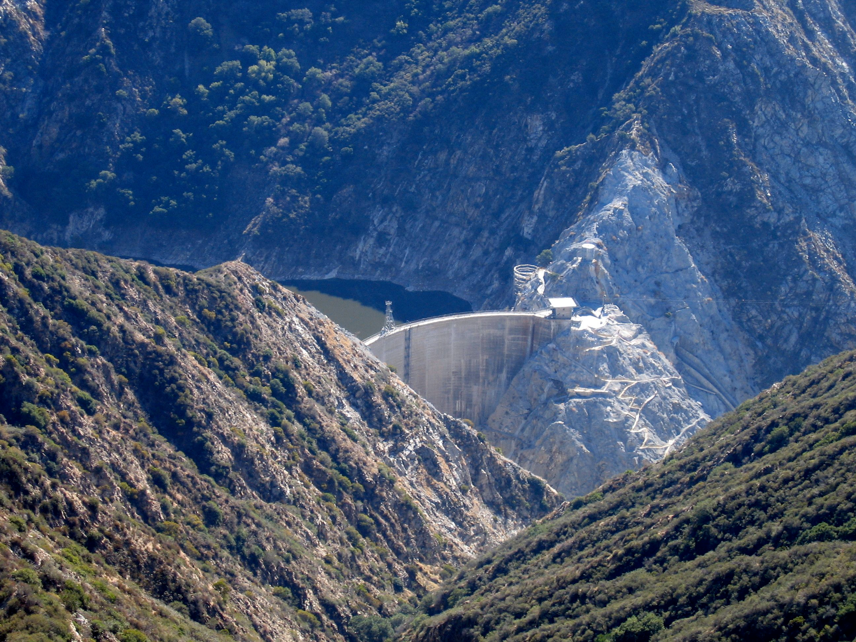
SH Waves and Topography
1971 San Fernando Earthquake, Magnitude 6.6
Highest PGA seemed to occur in mountainous regions
1.25g recorded at Pacoima Dam in San Gabriel Mountains
David Boore uses 2D topographic models
Computes shear wave amplitude along different points in profile
Compares amplitude to flat surface
http://en.wikipedia.org/wiki/Pacoima_Dam
(Boore, 1972)

Slide 29
Boore’s Conclusions
Amplification is dependent on wavelength and width of topographic feature
Steeper topography causes more drastic amplification
Amplitude of SH waves increases near tops of ridges (up to +75%) and decreases near base of hillslope
This model reflects high PGA values at Pacoima Dam during the San Fernando earthquake
(Boore, 1972)
Foam model of Pacoima Dam from Anooshepoor & Brune, 1989

Slide 31
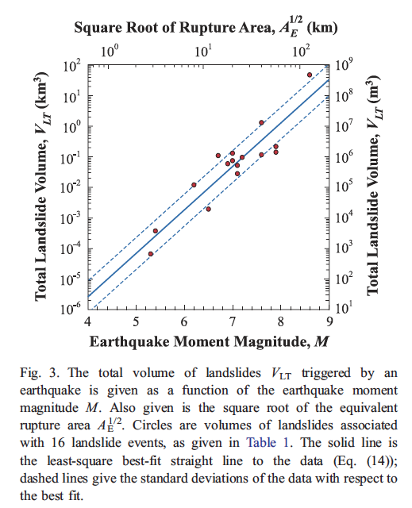

Slide 32
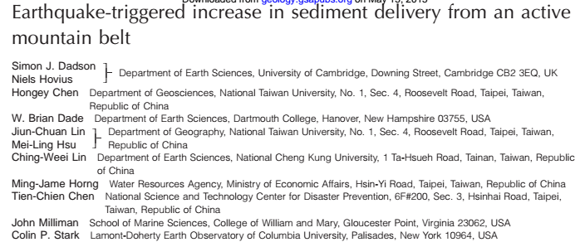
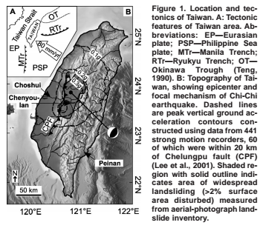
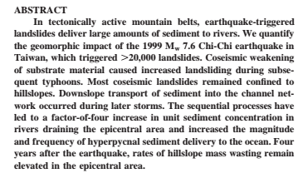

Slide 33
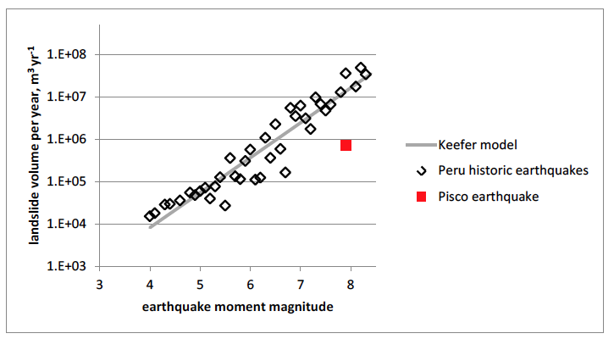
Seismically-induced landslides

Slide 34
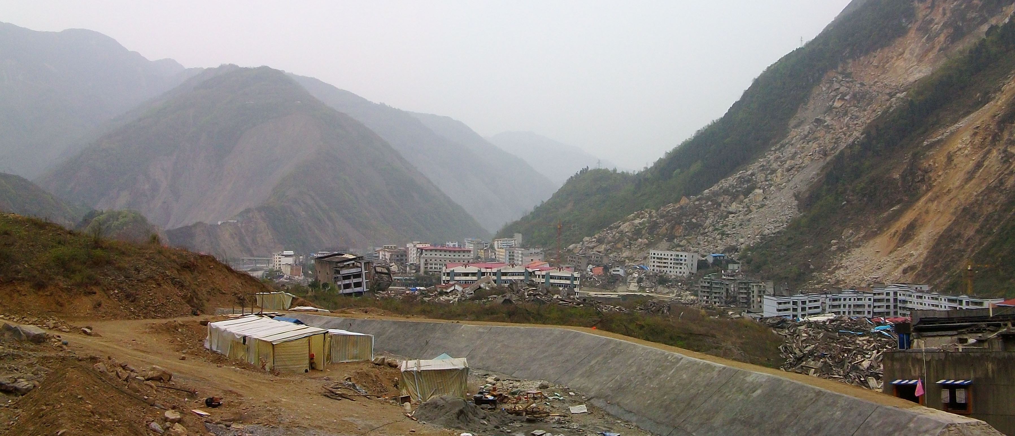
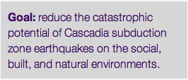
Seismically induced landslides

Slide 35
Background & Motivation:
Review of the current global seismic-landslide inventory shows that moderate-to-large earthquakes trigger 1000s of landslides over regions that can exceed (10,000 km2) (Keefer, 1984), resulting in a crude scaling between moment magnitude and landslide sediment volume (Keefer 1994; Malamud et al., 2004).
few tests of this in subduction zone settings!

Slide 36
Background & Motivation:
Earthquake-induced landslide hazard has been traditionally analyzed at the site-specific scale. There is a growing interest in expanding seismic landslide hazard assessment to substantially larger spatial scales.
Implementation of analysis tools developed specifically to assess landsliding related to subduction zone earthquakes would greatly aid the Puget Sound community in planning and response to future Cascadia events!

Slide 37
We will develop a statistical model to consider large magnitude earthquake-induced landslide hazards associated with subduction zone earthquakes in Cascadia and in other locations.

Slide 38
M9 Landslides Project Goals
Formulate, train, and optimize a logistic regression-predictive model using a database of landslides triggered by M9 Tohuku, Japan Earthquake (Wartman et al., 2013).
Produce a detailed landslide inventory for the greater Puget Sound region using LiDAR data, field observations, and geochronology to place age limits on larger, deep-seated landslides.
Independently assess model validity and accuracy by comparing prediction against landslides mapped from recent subduction events in Peru and older events in Cascadia (if we find them).
Develop an integrated database for the Puget Sound region (including new landslide inventory, topographic, geologic, vegetation, and ground motion data) that will provide necessary input to the statistical model.

Slide 39
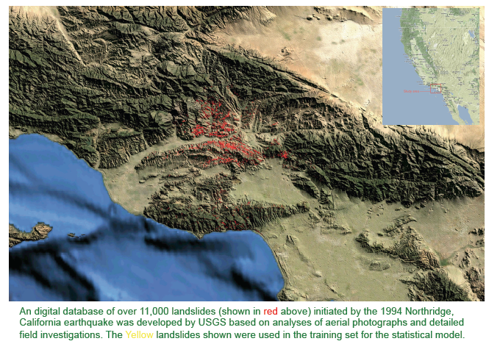
Potential Research Outcomes
Example from 1994 Northridge Quake:
Wartman and Gillespie “Statistical Modeling and Geospatial Simulation of Geologic Hazards”

Slide 40
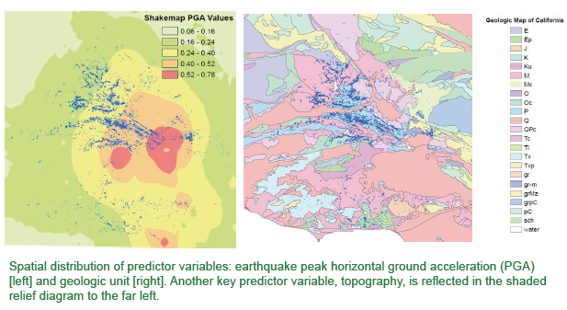
Potential Research Outcomes

Slide 41
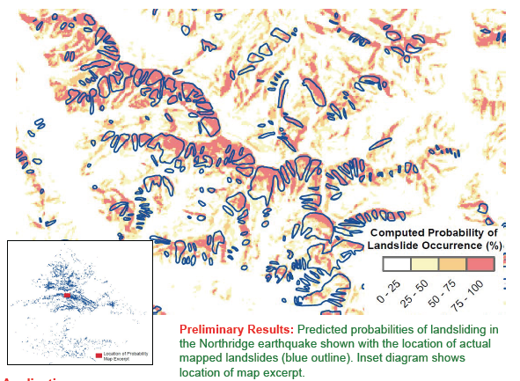
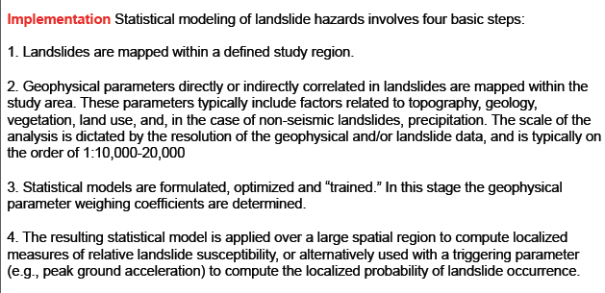
Potential Research Outcomes

Slide 42
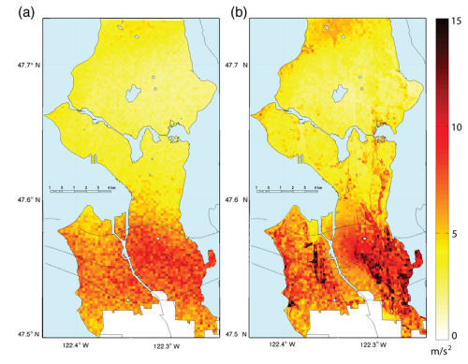
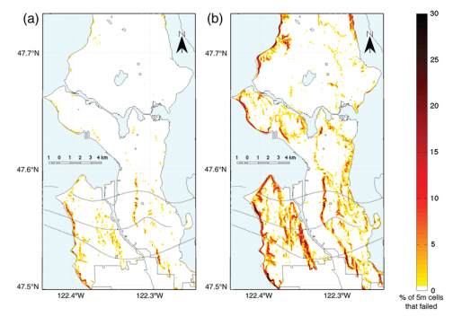
Potential Research Outcomes

Slide 43
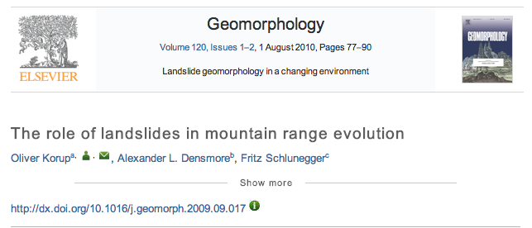
Potential Research Outcomes

Slide 44
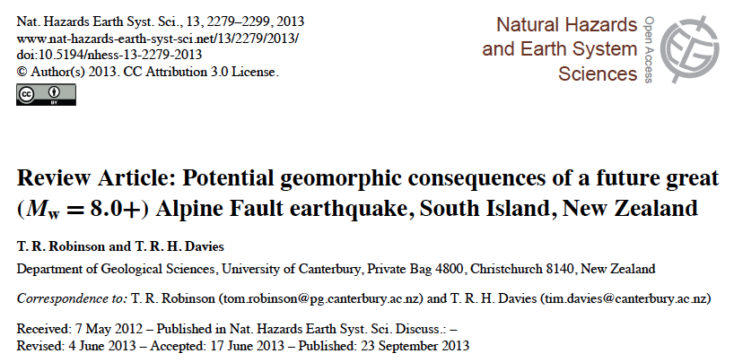
Potential Research Outcomes

Slide 45
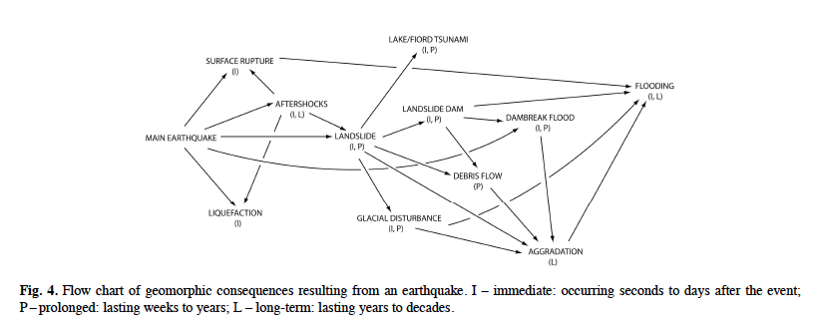
Potential Research Outcomes
Processes Considered:
Landsliding
Tsunami
Liquefaction
Aggradation
Debris Flows
Landslide dams
Dam break floods
Glacial Advance

Slide 46
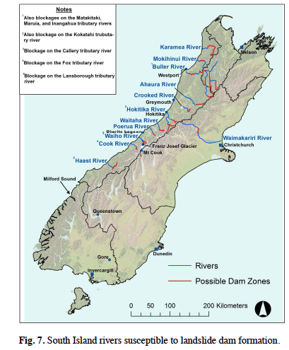
Potential Research Outcomes

