Slide 1

A low velocity layer (LVZ) at the top of the subducting plate has been detected in a majority of subduction zones.
LVZ may be a hydrated layer of oceanic crust caused by dehydration reactions as the plate subducts.
LVZ has interesting consequences for imaging the subduction zone and (potentially) seismogenesis.

Slide 2
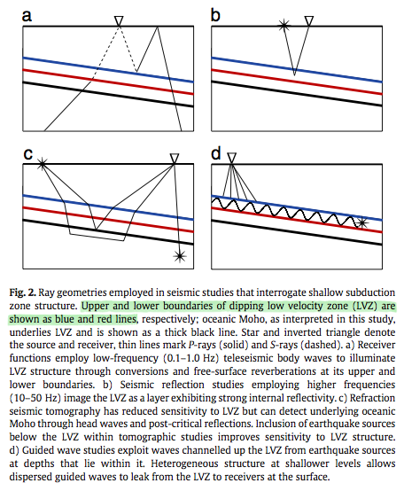
Interrogating Shallow
Subduction Zone Structure
Seismic wave conversions and reverberations
Seismic
reflection
studies
Refraction seismic tomography
Low velocity
wave guides
Blue & Red lines bound the LVZ
Black line = Oceanic Moho

Slide 3
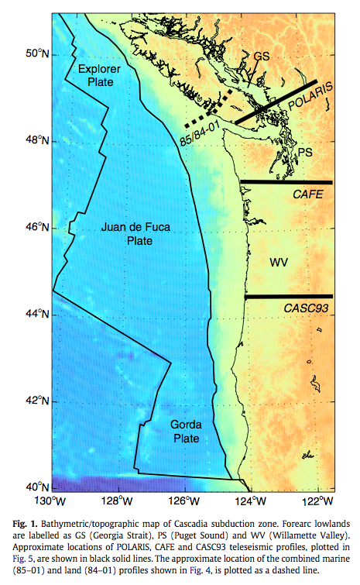
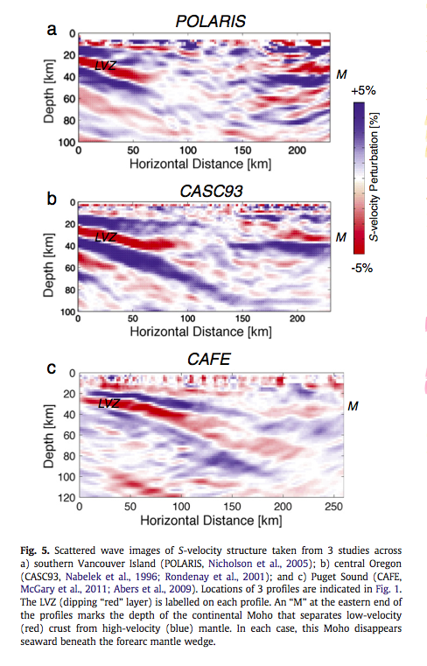
Imaging the LVZ

Slide 4
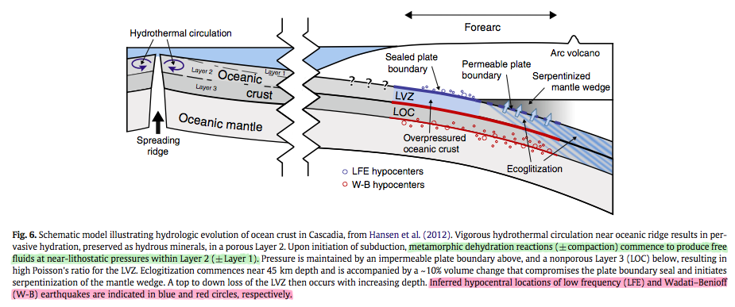
Schematic Model of
Hydrologic Evolution

Slide 5
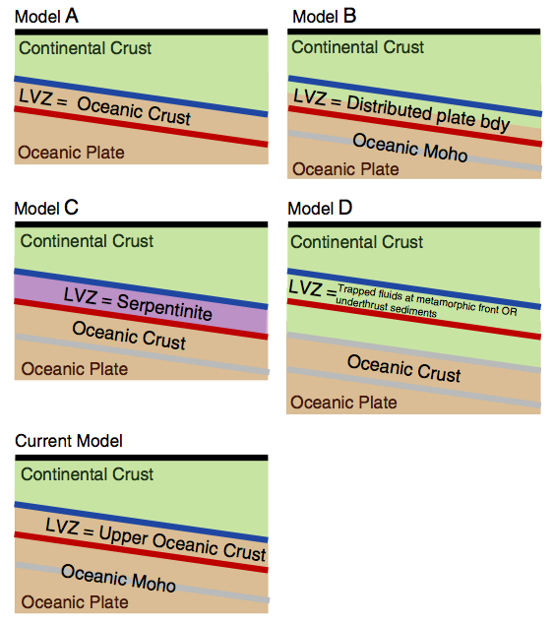
LVZ = Entire
Oceanic Crust
Distributed
Shear Zone
Fluid-rich Layer within the Overriding Continental Crust
Serpentinized
Mantle Layer
Possible Interpretations of the LVZ
This Paper:
Upper
Oceanic Crust

Slide 6
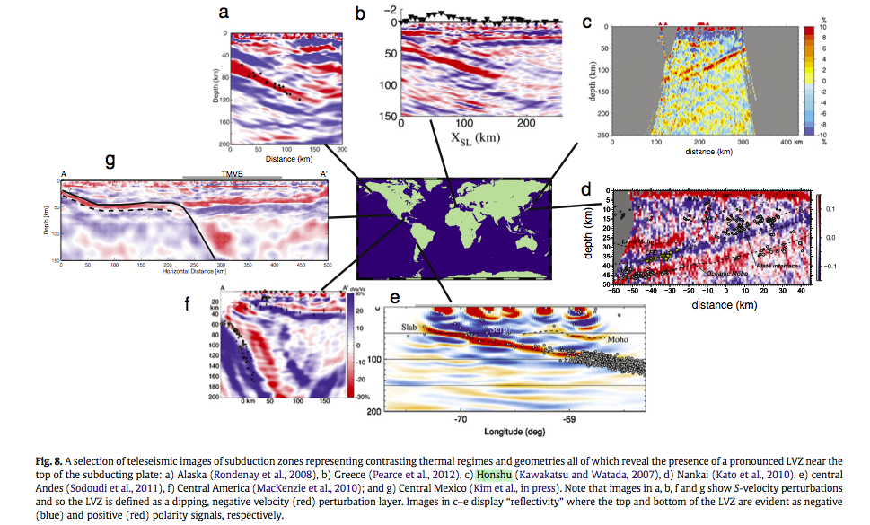
Global
Survey

Slide 7
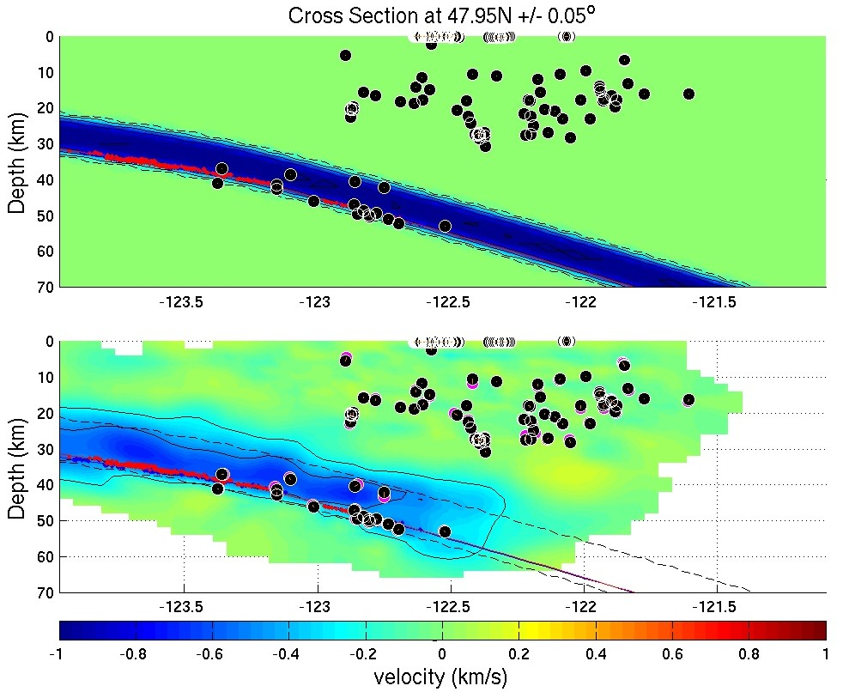

Slide 8
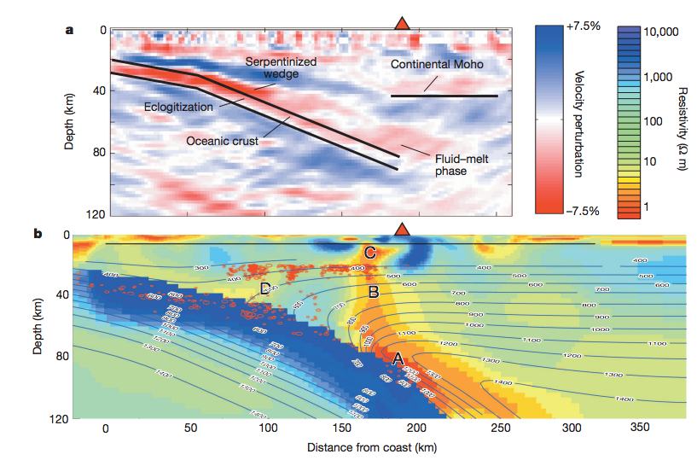
Magnetotellurics and Fluid Pathways beneath Volcanoes
McGary et al., Nature, 2014

Slide 9
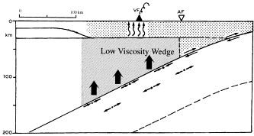
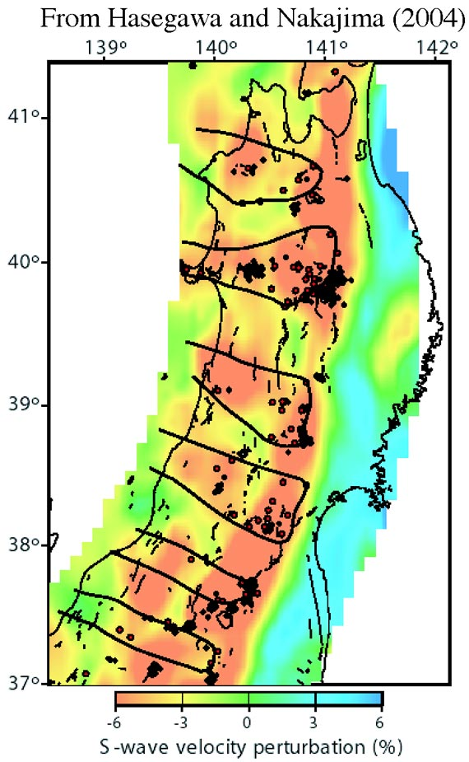
Fluids, Viscosity & Volcanism
Honda & Saito, 2003
Honda and Yoshida, 2005 (modified after Hasegawa and Nakajima, 2004)

Slide 10
Upper Mantle
How are high pore fluid pressures and dehydration reactions related to seismicity (i.e., tremor, Wadati-Benioff zone seismicity)?
  Along-strike variations?
What are the pathways for volatiles and melt in the subduction system and how does this ultimately manifest as surface volcanism?
Lower Mantle
How do slab fragments contribute to surface magmatism?
Why do some slabs bend and stagnate while others penetrate into the deep mantle? What does this mean for material transport?

Slide 11
Upper Mantle
How are high pore fluid pressures and dehydration reactions related to seismicity (i.e., tremor, Wadati-Benioff zone seismicity)?
  Along-strike variations?
What are the pathways for volatiles and melt in the subduction system and how does this ultimately manifest as surface volcanism?
Lower Mantle
How do slab fragments contribute to surface magmatism?
Why do some slabs bend and stagnate while others penetrate into the deep mantle? What does this mean for material transport?
Subduction Zone Observatory Wish List
Ocean Bottom Seismometers
Long Running Networks (on land and offshore)
Magnetotelluric Surveying
Does a subduction zone observatory need to be confined to subduction zones??
…

Slide 12
