Slide 1
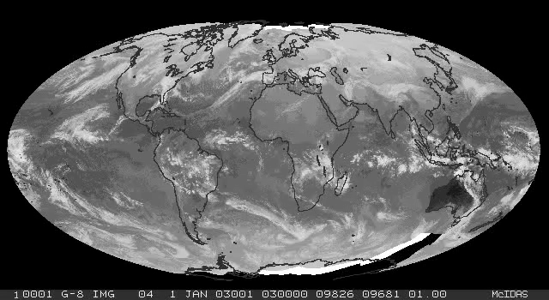
The atmospheric circulation

Slide 2
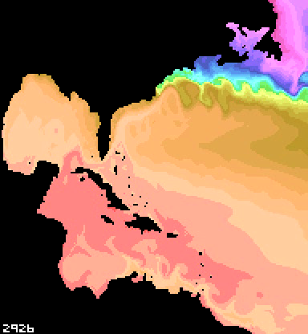
North Atlantic surface circulation

Slide 3
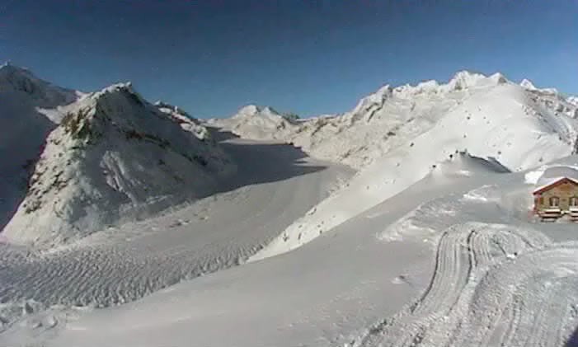
Ice flow (Grosser Aletsch glacier, Switzerland)

